Slide 1
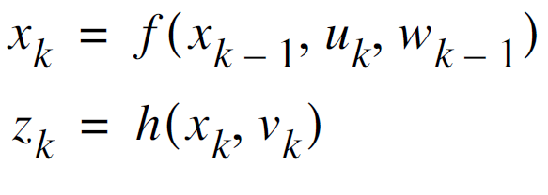
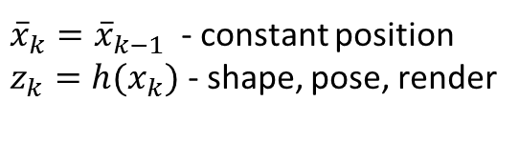
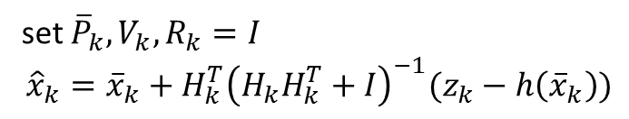
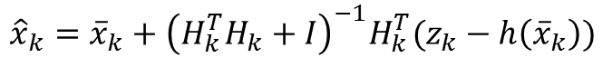
One iteration of LM
Extended Kalman Filter
${\overline{x}}_{k}={\overline{x}}_{k−1}$ - constant position
$z_{k}=h(x_{k})$ - shape, pose, render
$${\hat{x}}_{k}={\overline{x}}_{k}+{{\left(H_{k}^{T}H_{k}+I\right)}^{−1}H}_{k}^{T}(z_{k}−h\left({\overline{x}}_{k}\right))$$
set ${\overline{P}}_{k}, V_{k}, R_{k}=I$
$${\hat{x}}_{k}={\overline{x}}_{k}+H_{k}^{T}{\left(H_{k}H_{k}^{T}+I\right)}^{−1}(z_{k}−h\left({\overline{x}}_{k}\right))$$

Slide 2
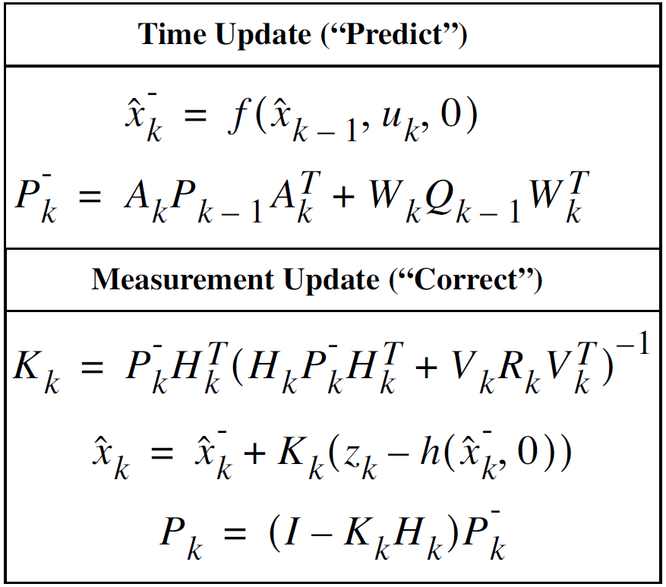
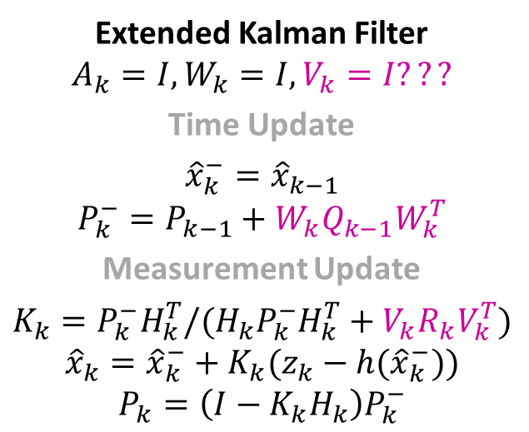
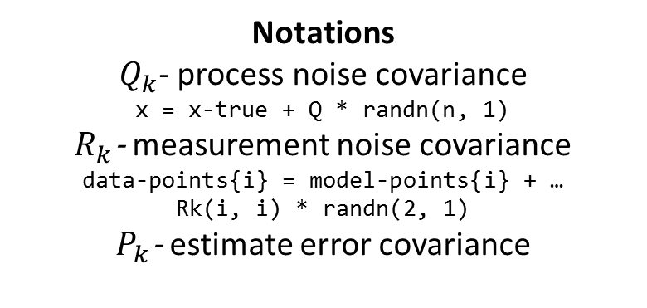
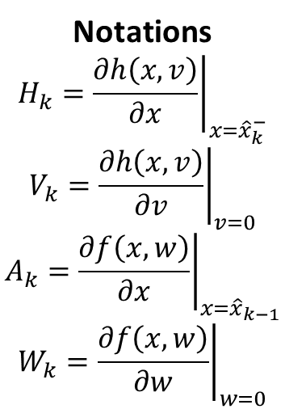
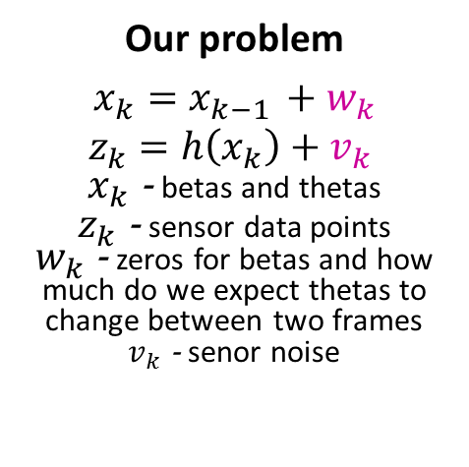
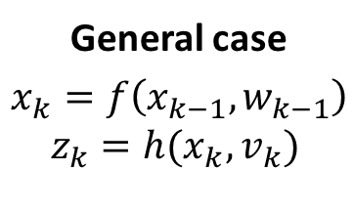
General case
$$x_{k}=f\left(x_{k−1}, w_{k−1}\right)$$
$$z_{k}=h(x_{k}, v_{k})$$
Our problem
$$x_{k}=x_{k−1 }+w_{k}$$
$$z_{k}=h\left(x_{k}\right)+v_{k}$$
$x_{k}$ - betas and thetas
$z_{k}$ - sensor data points
$w_{k}$ - zeros for betas and how much do we expect thetas to change between two frames
$v_{k}$ - senor noise
Notations
$$H_{k}={\left.\frac{∂h\left(x, v\right)}{∂x}\right|}_{x={\hat{x}}_{k}^{−}}$$
$$V_{k}={\left.\frac{∂h\left(x, v\right)}{∂v}\right|}_{v=0}$$
$$A_{k}={\left.\frac{∂f\left(x, w\right)}{∂x}\right|}_{x={\hat{x}}_{k−1}}$$
$$W_{k}={\left.\frac{∂f\left(x, w\right)}{∂w}\right|}_{w=0}$$
Notations
$Q_{k}$- process noise covariance
x = x-true + Q * randn(n, 1)
$R_{k}$- measurement noise covariance
data-points{i} = model-points{i} + …
Rk(i, i) * randn(2, 1)
$P_{k}$- estimate error covariance
Extended Kalman Filter
$$A_{k}=I, {W_{k}=I, V}_{k}=I???$$
Time Update
$${\hat{x}}_{k}^{−}={\hat{x}}_{k−1}$$
$$P_{k}^{−}=P_{k−1}+{W_{k}Q}_{k−1}W_{k}^{T}$$
Measurement Update
$$K_{k}=P_{k}^{−}H_{k}^{T}/{(H_{k}P}_{k}^{−}H_{k}^{T}+{V_{k}R}_{k}V_{k}^{T})$$
$${\hat{x}}_{k}={\hat{x}}_{k}^{−}+K_{k}(z_{k}−h({\hat{x}}_{k}^{−}))$$
$$P_{k}=\left(I−K_{k}H_{k}\right)P_{k}^{−}$$

Slide 3
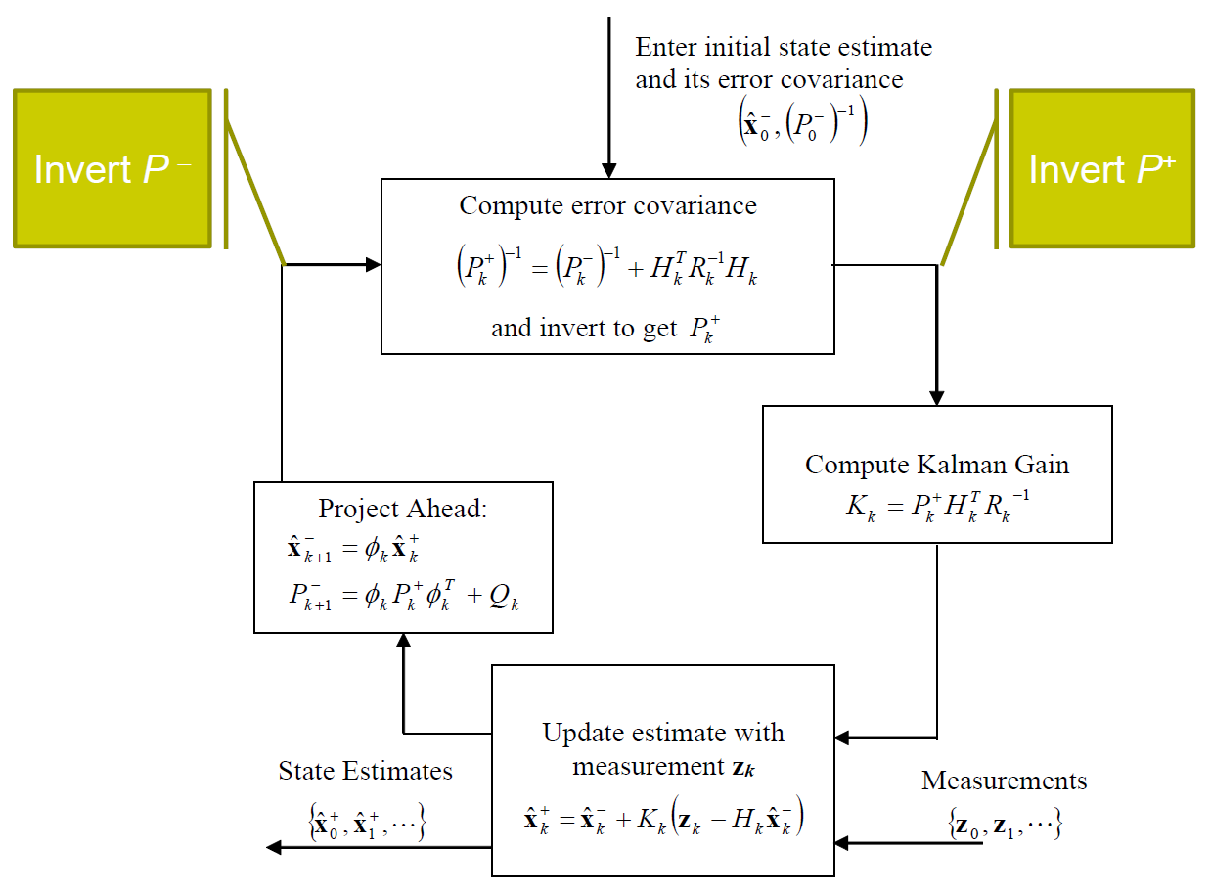

Slide 4
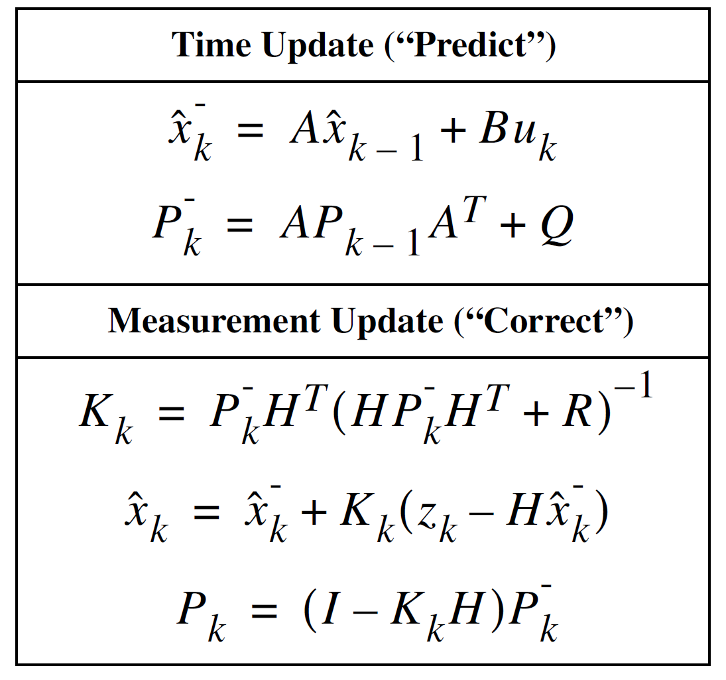
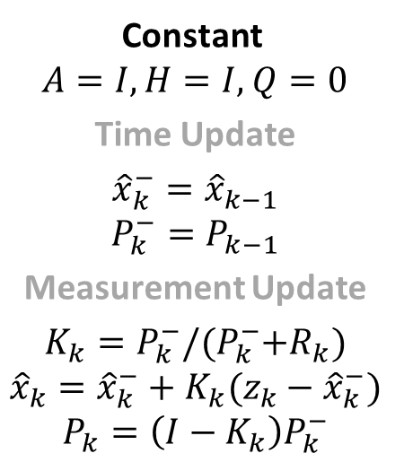
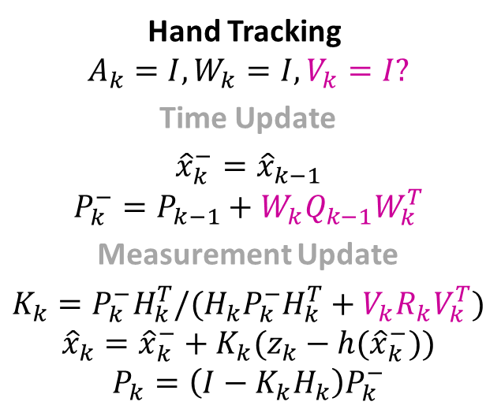
Constant
$A=I, H=I,$ $Q=0$
Time Update
$${\hat{x}}_{k}^{−}={\hat{x}}_{k−1}$$
$$P_{k}^{−}=P_{k−1}$$
Measurement Update
$$K_{k}=P_{k}^{−}/{(P}_{k}^{−}+R_{k})$$
$${\hat{x}}_{k}={\hat{x}}_{k}^{−}+K_{k}(z_{k}−{\hat{x}}_{k}^{−})$$
$$P_{k}=\left(I−K_{k}\right)P_{k}^{−}$$
Hand Tracking
$$A_{k}=I, {W_{k}=I, V}_{k}=I?$$
Time Update
$${\hat{x}}_{k}^{−}={\hat{x}}_{k−1}$$
$$P_{k}^{−}=P_{k−1}+{W_{k}Q}_{k−1}W_{k}^{T}$$
Measurement Update
$$K_{k}=P_{k}^{−}H_{k}^{T}/{(H_{k}P}_{k}^{−}H_{k}^{T}+{V_{k}R}_{k}V_{k}^{T})$$
$${\hat{x}}_{k}={\hat{x}}_{k}^{−}+K_{k}(z_{k}−h({\hat{x}}_{k}^{−}))$$
$$P_{k}=\left(I−K_{k}H_{k}\right)P_{k}^{−}$$

Slide 5
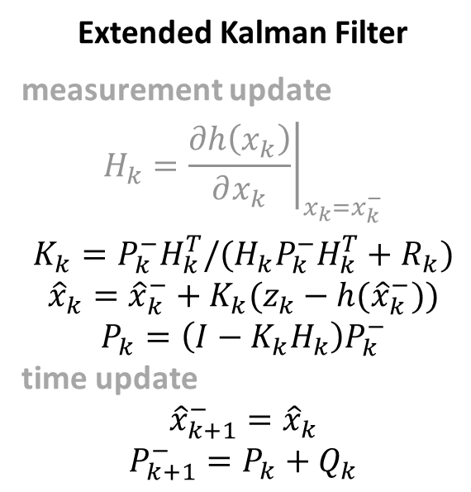
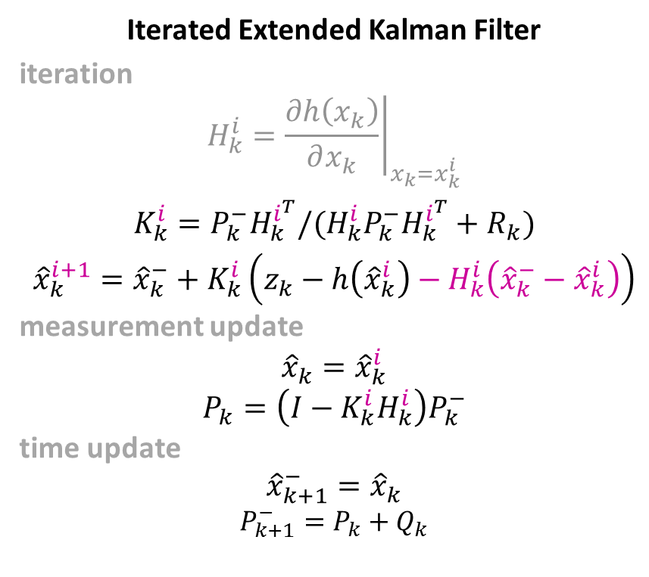
Extended Kalman Filter
measurement update
$$H_{k}={\left.\frac{∂h\left(x_{k}\right)}{∂x_{k}}\right|}_{x_{k}=x_{k}^{−}}$$
$$K_{k}=P_{k}^{−}H_{k}^{T}/{(H_{k}P}_{k}^{−}H_{k}^{T}+R_{k})$$
$${\hat{x}}_{k}={\hat{x}}_{k}^{−}+K_{k}(z_{k}−h({\hat{x}}_{k}^{−}))$$
$$P_{k}=\left(I−K_{k}H_{k}\right)P_{k}^{−}$$
time update
$${\hat{x}}_{k+1}^{−}={\hat{x}}_{k}$$
$$P_{k+1}^{−}=P_{k}+Q_{k}$$
Iterated Extended Kalman Filter
iteration
$$H_{k}^{i}={\left.\frac{∂h\left(x_{k}\right)}{∂x_{k}}\right|}_{x_{k}=x_{k}^{i}}$$
$$K_{k}^{i}=P_{k}^{−}H_{k}^{i^{T}}/{(H_{k}^{i}P}_{k}^{−}H_{k}^{i^{T}}+R_{k})$$
$${\hat{x}}_{k}^{i+1}={\hat{x}}_{k}^{−}+K_{k}^{i}\left(z_{k}−h\left({\hat{x}}_{k}^{i}\right)−H_{k}^{i}\left({\hat{x}}_{k}^{−}−{\hat{x}}_{k}^{i}\right)\right)$$
measurement update
$${\hat{x}}_{k}={\hat{x}}_{k}^{i}$$
$$P_{k}=\left(I−K_{k}^{i}H_{k}^{i}\right)P_{k}^{−}$$
time update
$${\hat{x}}_{k+1}^{−}={\hat{x}}_{k}$$
$$P_{k+1}^{−}=P_{k}+Q_{k}$$

Slide 6
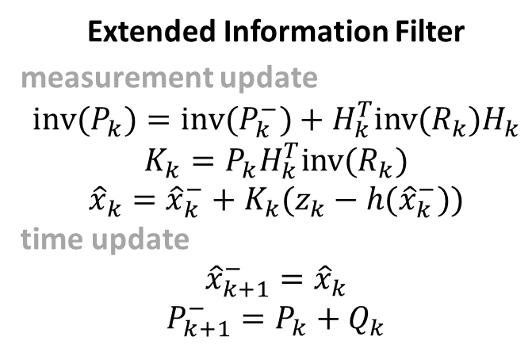
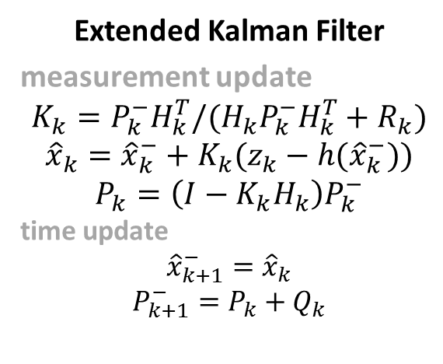
Extended Kalman Filter
measurement update
$$K_{k}=P_{k}^{−}H_{k}^{T}/{(H_{k}P}_{k}^{−}H_{k}^{T}+R_{k})$$
$${\hat{x}}_{k}={\hat{x}}_{k}^{−}+K_{k}(z_{k}−h({\hat{x}}_{k}^{−}))$$
$$P_{k}=\left(I−K_{k}H_{k}\right)P_{k}^{−}$$
time update
$${\hat{x}}_{k+1}^{−}={\hat{x}}_{k}$$
$$P_{k+1}^{−}=P_{k}+Q_{k}$$
Extended Information Filter
measurement update
$${inv(P}_{k})={inv(P}_{k}^{−})+H_{k}^{T}inv(R_{k})H_{k}$$
$$K_{k}=P_{k}H_{k}^{T}inv(R_{k})$$
$${\hat{x}}_{k}={\hat{x}}_{k}^{−}+K_{k}(z_{k}−h({\hat{x}}_{k}^{−}))$$
time update
$${\hat{x}}_{k+1}^{−}={\hat{x}}_{k}$$
$$P_{k+1}^{−}=P_{k}+Q_{k}$$

Slide 7
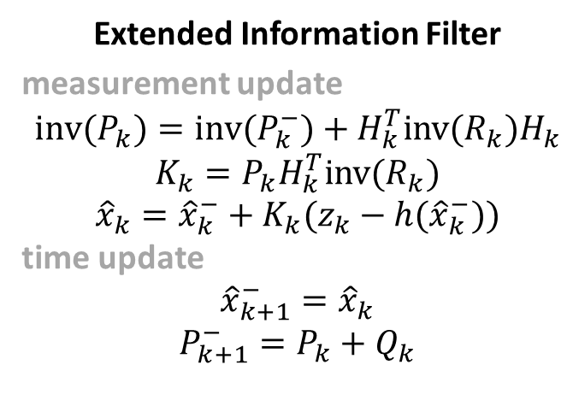
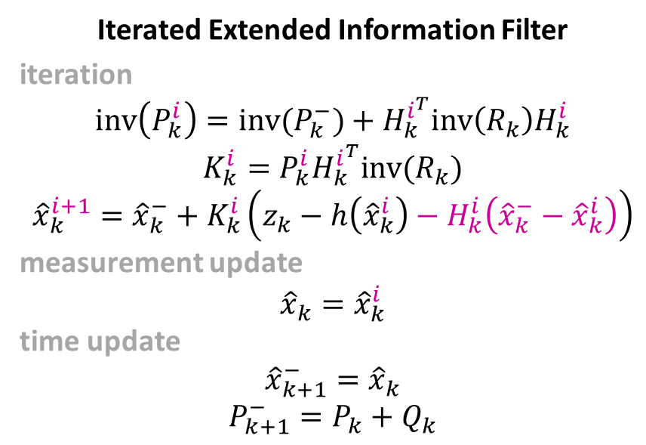
Extended Information Filter
measurement update
$${inv(P}_{k})={inv(P}_{k}^{−})+H_{k}^{T}inv(R_{k})H_{k}$$
$$K_{k}=P_{k}H_{k}^{T}inv(R_{k})$$
$${\hat{x}}_{k}={\hat{x}}_{k}^{−}+K_{k}(z_{k}−h({\hat{x}}_{k}^{−}))$$
time update
$${\hat{x}}_{k+1}^{−}={\hat{x}}_{k}$$
$$P_{k+1}^{−}=P_{k}+Q_{k}$$
Iterated Extended Information Filter
iteration
$${inv\left(P_{k}^{i}\right)=inv(P}_{k}^{−})+H_{k}^{i^{T}}inv\left(R_{k}\right)H_{k}^{i}$$
$$K_{k}^{i}=P_{k}^{i}H_{k}^{i^{T}}inv(R_{k})$$
$${\hat{x}}_{k}^{i+1}={\hat{x}}_{k}^{−}+K_{k}^{i}\left(z_{k}−h\left({\hat{x}}_{k}^{i}\right)−H_{k}^{i}\left({\hat{x}}_{k}^{−}−{\hat{x}}_{k}^{i}\right)\right)$$
measurement update
$${\hat{x}}_{k}={\hat{x}}_{k}^{i}$$
time update
$${\hat{x}}_{k+1}^{−}={\hat{x}}_{k}$$
$$P_{k+1}^{−}=P_{k}+Q_{k}$$

Slide 8
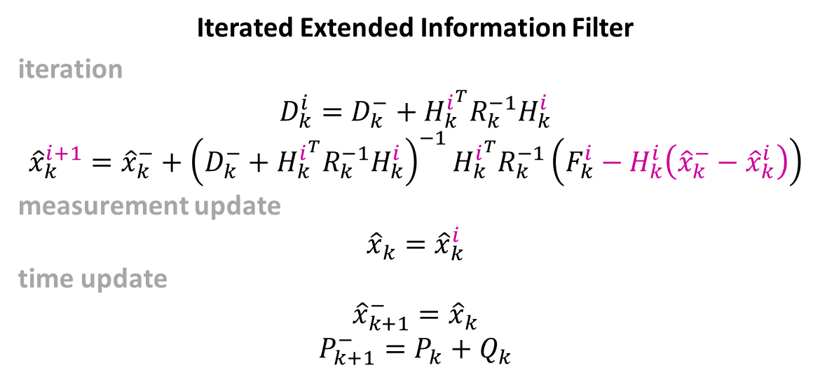
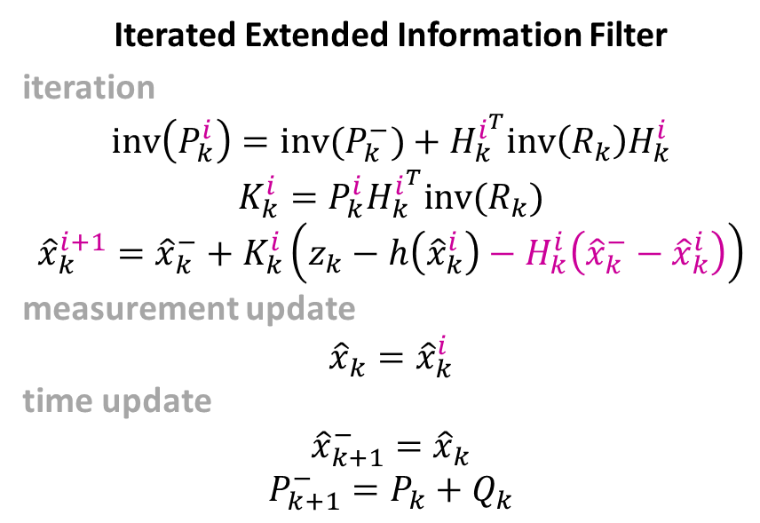
Iterated Extended Information Filter
iteration
$${inv\left(P_{k}^{i}\right)=inv(P}_{k}^{−})+H_{k}^{i^{T}}inv\left(R_{k}\right)H_{k}^{i}$$
$$K_{k}^{i}=P_{k}^{i}H_{k}^{i^{T}}inv(R_{k})$$
$${\hat{x}}_{k}^{i+1}={\hat{x}}_{k}^{−}+K_{k}^{i}\left(z_{k}−h\left({\hat{x}}_{k}^{i}\right)−H_{k}^{i}\left({\hat{x}}_{k}^{−}−{\hat{x}}_{k}^{i}\right)\right)$$
measurement update
$${\hat{x}}_{k}={\hat{x}}_{k}^{i}$$
time update
$${\hat{x}}_{k+1}^{−}={\hat{x}}_{k}$$
$$P_{k+1}^{−}=P_{k}+Q_{k}$$
Iterated Extended Information Filter
iteration
$${D_{k}^{i}=D}_{k}^{−}+H_{k}^{i^{T}}R_{k}^{−1}H_{k}^{i}$$
$${\hat{x}}_{k}^{i+1}={\hat{x}}_{k}^{−}+{\left(D_{k}^{−}+H_{k}^{i^{T}}R_{k}^{−1}H_{k}^{i}\right)}^{−1}H_{k}^{i^{T}}R_{k}^{−1}\left(F_{k}^{i}−H_{k}^{i}\left({\hat{x}}_{k}^{−}−{\hat{x}}_{k}^{i}\right)\right)$$
measurement update
$${\hat{x}}_{k}={\hat{x}}_{k}^{i}$$
time update
$${\hat{x}}_{k+1}^{−}={\hat{x}}_{k}$$
$$P_{k+1}^{−}=P_{k}+Q_{k}$$

Slide 9
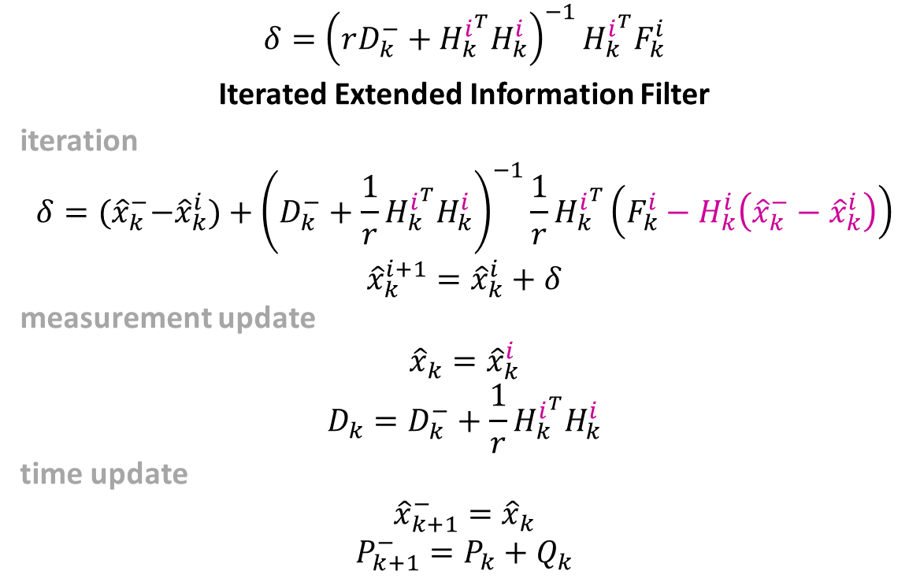
$$δ={\left(rD_{k}^{−}+H_{k}^{i^{T}}H_{k}^{i}\right)}^{−1}H_{k}^{i^{T}}F_{k}^{i}$$
Iterated Extended Information Filter
iteration
$$δ={(\hat{x}}_{k}^{−}−{\hat{x}}_{k}^{i})+{\left(D_{k}^{−}+{\frac{1}{r}H}_{k}^{i^{T}}H_{k}^{i}\right)}^{−1}{\frac{1}{r}H}_{k}^{i^{T}}\left(F_{k}^{i}−H_{k}^{i}\left({\hat{x}}_{k}^{−}−{\hat{x}}_{k}^{i}\right)\right)$$
$${\hat{x}}_{k}^{i+1}={\hat{x}}_{k}^{i}+δ$$
measurement update
$${\hat{x}}_{k}={\hat{x}}_{k}^{i}$$
$$D_{k}=D_{k}^{−}+{\frac{1}{r}H}_{k}^{i^{T}}H_{k}^{i}$$
time update
$${\hat{x}}_{k+1}^{−}={\hat{x}}_{k}$$
$$P_{k+1}^{−}=P_{k}+Q_{k}$$
$$δ={\left(rD+J^{T}J\right)}^{−1}J^{T}F+\left({\left(rD+J^{T}J\right)}^{−1}J^{T}J−I\right)\left({\hat{x}}_{k}^{−}−{\hat{x}}_{k}^{i}\right)$$

Slide 10
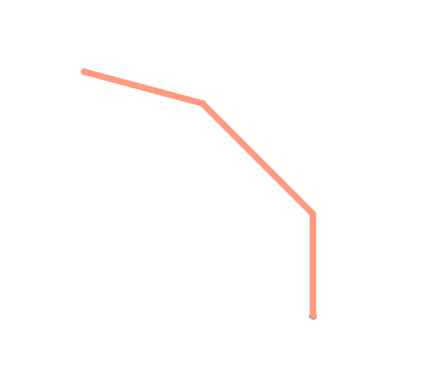
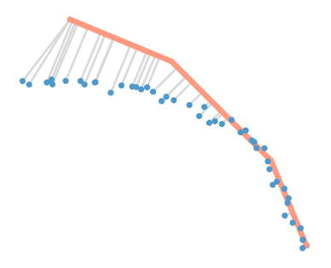
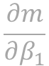
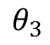
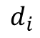
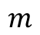
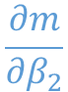
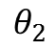
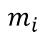
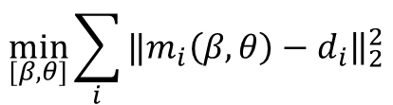
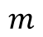
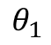
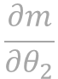
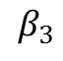
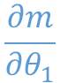
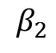
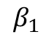
$$β_{3}$$
$$θ_{3}$$
$$\frac{∂m}{∂β_{1}}$$
$$\frac{∂m}{∂θ_{1}}$$
$$\frac{∂m}{∂β_{2}}$$
$$m$$
$$β_{2}$$
$$\frac{∂m}{∂θ_{2}}$$
$$m$$
$$θ_{2}$$
$$β_{1}$$
$$θ_{1}$$
$$m_{i}$$
$$d_{i}$$
$$\min_{[β, θ]}{\sum_{i}{‖{\left.​m_{i}\left(β, θ\right)−d_{i}\right\|}_{2}^{2}}}$$

Slide 11
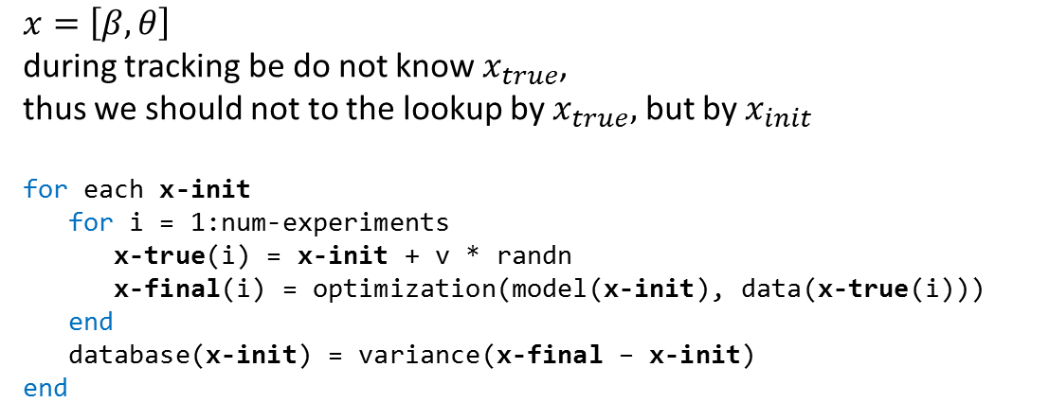
$x=\left[β, θ\right]$
during tracking be do not know $x_{true}$,
thus we should not to the lookup by $x_{true},$ but by $x_{init}$
for each x-init
for i = 1:num-experiments
x-true(i) = x-init + v * randn
x-final(i) = optimization(model(x-init), data(x-true(i)))
end
database(x-init) = variance(x-final – x-init)
end

Slide 12
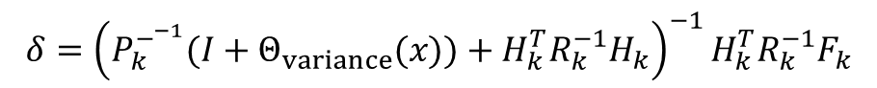
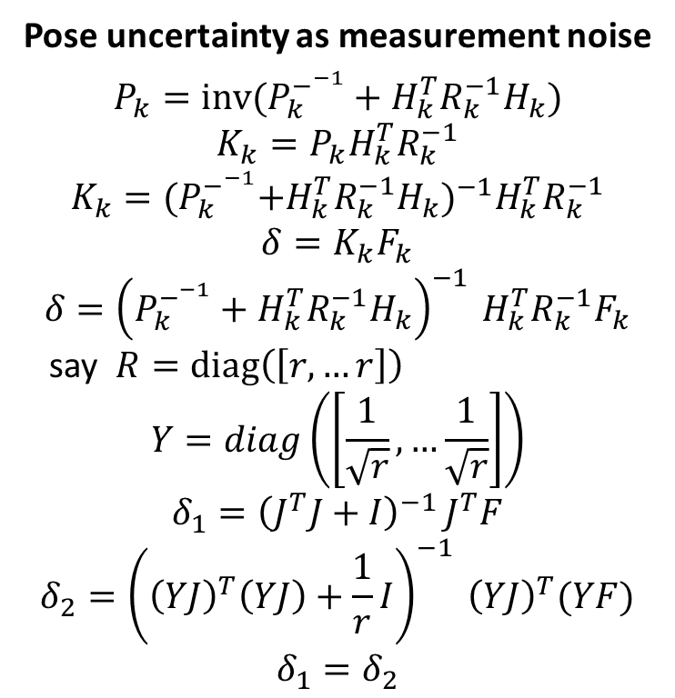
Pose uncertainty as measurement noise
$$P_{k}={inv(P}_{k}^{−^{−1}}+H_{k}^{T}R_{k}^{−1}H_{k})$$
$$K_{k}=P_{k}H_{k}^{T}R_{k}^{−1}$$
$$K_{k}={{(P}_{k}^{−^{−1}}+H_{k}^{T}R_{k}^{−1}H_{k})}^{−1}H_{k}^{T}R_{k}^{−1}$$
$$δ=K_{k}F_{k}$$
$$δ={\left(P_{k}^{−^{−1}}+H_{k}^{T}R_{k}^{−1}H_{k}\right)}^{−1 }H_{k}^{T}R_{k}^{−1}F_{k}$$
say $R=diag\left(\left[r, …r\right]\right)$
$$Y=diag\left(\left[\frac{1}{\sqrt{r}}, …\frac{1}{\sqrt{r}}\right]\right)$$
$$δ_{1}={\left(J^{T}J+I\right)}^{−1 }J^{T}F$$
$$δ_{2}={\left({\left(YJ\right)}^{T}\left(YJ\right)+\frac{1}{r}I\right)}^{−1 }{\left(YJ\right)}^{T}(YF)$$
$$δ_{1}=δ_{2}$$
$$δ={\left(P_{k}^{−^{−1}}(I+Θ_{variance}(x))+H_{k}^{T}R_{k}^{−1}H_{k}\right)}^{−1 }H_{k}^{T}R_{k}^{−1}F_{k}$$

Slide 13
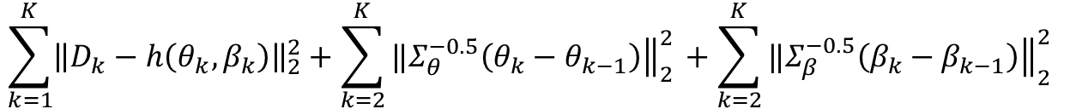
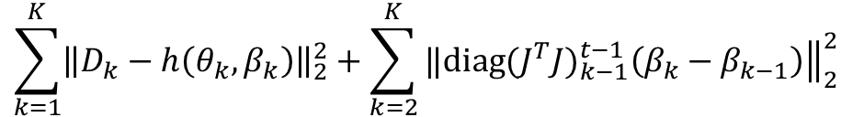
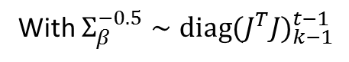
$$\sum_{k=1}^{K}{{\left\|D_{k}−h\left(θ_{k}, β_{k}\right)\right\|}_{2}^{2}+\sum_{k=2}^{K}{‖{\left.​\left(θ_{k}−θ_{k−1}\right)Σ_{θ}^{−1}\left(θ_{k}−θ_{k−1}\right)\right\|}_{2}^{2 }+\sum_{k=2}^{K}{‖{\left.​\left(β_{k}−β_{k−1}\right)Σ_{β}^{−1}\left(β_{k}−β_{k−1}\right)\right\|}_{2}^{2 } }}}$$
$$\sum_{k=1}^{K}{{\left\|D_{k}−h\left(θ_{k}, β_{k}\right)\right\|}_{2}^{2}+\sum_{k=2}^{K}{‖{\left.​Σ_{θ}^{−0.5}\left(θ_{k}−θ_{k−1}\right)\right\|}_{2}^{2 }+\sum_{k=2}^{K}{‖{\left.​Σ_{β}^{−0.5}\left(β_{k}−β_{k−1}\right)\right\|}_{2}^{2 } }}}$$
$$\sum_{k=1}^{K}{{\left\|D_{k}−h\left(θ_{k}, β_{k}\right)\right\|}_{2}^{2}+\sum_{k=2}^{K}{‖{\left.​{{diag(J}^{T}J)}_{k−1}^{t−1}\left(β_{k}−β_{k−1}\right)\right\|}_{2}^{2 } }}$$
With $Σ_{β}^{−0.5}∼{{diag(J}^{T}J)}_{k−1}^{t−1}$
Why do we need a separate variable $β$ for each frame?
With separate $β_{k}$ we can look at $J_{k}^{T}J_{k}$ after optimization to estimate importance of $β_{k}^{i}$ in each frame

Slide 14
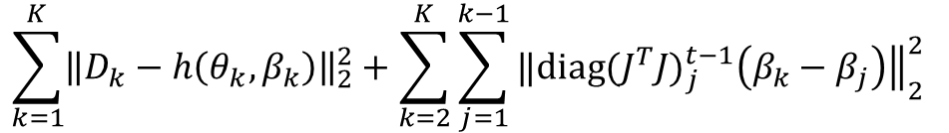
certain frame
certain frame
un-certain frame
un-certain frame
certain frame
certain frame
certain frame
certain frame
un-certain frame
un-certain frame
certain frame
certain frame
$$\sum_{k=1}^{K}{{\left\|D_{k}−h\left(θ_{k}, β_{k}\right)\right\|}_{2}^{2}+\sum_{k=2}^{K}{\sum_{j=1}^{k−1}{‖{\left.​{{diag(J}^{T}J)}_{j}^{t−1}\left(β_{k}−β_{j}\right)\right\|}_{2}^{2 }} }}$$

Slide 15
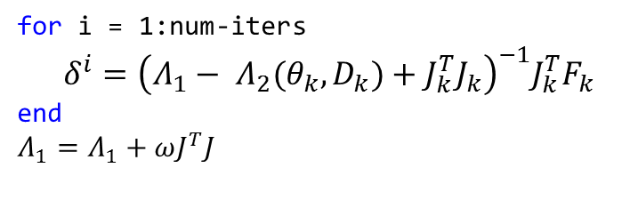
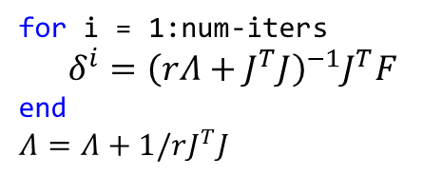
for i = 1:num-iters
$δ^{i}={\left(rΛ+J^{T}J\right)}^{−1}J^{T}F$
end
$Λ=Λ+1/rJ^{T}J$
for i = 1:num-iters
$δ^{i}={\left({Λ_{1}− Λ}_{2}(θ_{k}, D_{k})+J_{k}^{T}J_{k}\right)}^{−1}J_{k}^{T}F_{k}$
end
$Λ_{1}=Λ_{1}+ωJ^{T}J$

Slide 16
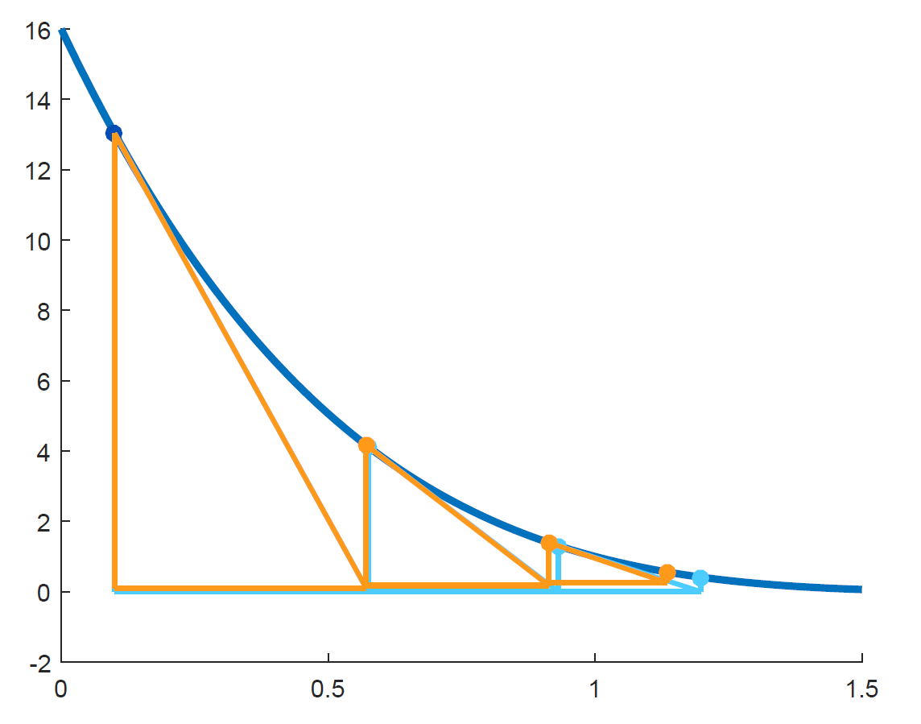





$$≈f(x_{0})$$
$$x_{i+1}=x_{i}−\frac{df(x_{i}) f(x_{i})}{df(x_{i})df(x_{i})+λ}$$
$$x_{i+1}=x_{0}−\frac{df\left(x_{i}\right)\left(\overbrace{f\left(x_{i}\right)+df\left(x_{i}\right)\left(x_{0}−x\right)}\right)}{df(x_{i})df(x_{i})+λ}$$
$$x_{i+1}=x_{0}−\frac{df\left(x_{i}\right)f(x_{0})}{df(x_{i})df(x_{i})+λ}$$
Thus, damping would be a fraction of the update counting from $x_{0}$, with this approach the updates are smaller and may even be negative

Slide 17


Iterated Extended Information Filter
iteration
$${inv\left(P_{k}^{i}\right)=inv(P}_{k}^{−})+H_{k}^{i^{T}}inv\left(R_{k}\right)H_{k}^{i}$$
$$K_{k}^{i}=P_{k}^{i}H_{k}^{i^{T}}inv(R_{k})$$
$${\hat{x}}_{k}^{i+1}={\hat{x}}_{k}^{−}+K_{k}^{i}\left(z_{k}−h\left({\hat{x}}_{k}^{i}\right)−H_{k}^{i}\left({\hat{x}}_{k}^{−}−{\hat{x}}_{k}^{i}\right)\right)$$
time update
$${\hat{x}}_{k+1}^{−}={\hat{x}}_{k}$$
$$P_{k+1}^{−}=P_{k}+Q_{k}$$
IEIF in LM notation
denote $C≝P^{−1}$ - certainty
say $R=diag(\left[r, …, r\right])$
iteration
$${\tilde{F}}^{0}=F^{i}+J^{i}(x^{0}−x^{i})$$
$$x^{i+1}=x^{0}+{\left({J^{i}}^{T}J^{i}+r C^{−}\right)}^{−1}{J^{i}}^{T}{\tilde{F}}^{0}$$
time update
$$C=C^{−}+\frac{1}{r}{J^{i}}^{T}J^{i}$$
$$C^{−}={{(C}^{−1}+Q)}^{−1}$$

Slide 18


Original
iteration
$$x^{i+1}=x^{0}+{\left({J^{i}}^{T}J^{i}+r C^{−}\right)}^{−1}{J^{i}}^{T}{\tilde{F}}^{0}$$
time update
$$C=C^{−}+1/r{{ J}^{i}}^{T}J^{i}$$
$$C^{−}={{(C}^{−1}+Q)}^{−1}$$
Max Update
iteration
$$x^{i+1}=x^{0}+{\left({J^{i}}^{T}J^{i}+rC^{−}\right)}^{−1}{J^{i}}^{T}{\tilde{F}}^{0}$$
time update
$$C={max⁡(C}^{−}, 1/r{{ diag(J}^{i}}^{T}J^{i}))$$
$$C^{−}={{(C}^{−1}+Q)}^{−1}$$

Slide 19

Original
iteration
$$x^{i+1}=x^{0}+{\left({J^{i}}^{T}J^{i}+r C^{−}\right)}^{−1}{J^{i}}^{T}{\tilde{F}}^{0}$$
time update
$$C=C^{−}+1/r{{ J}^{i}}^{T}J^{i}$$
$$C^{−}={{(C}^{−1}+Q)}^{−1}$$
Decreased Update
iteration
$$x^{i+1}=x^{0}+{\left({J^{i}}^{T}J^{i}+rC^{−}\right)}^{−1}{J^{i}}^{T}{\tilde{F}}^{0}$$
time update
$$C=C^{−}+ω/r{{ diag(J}^{i}}^{T}J^{i})$$
$$C^{−}={{(C}^{−1}+Q)}^{−1}$$

Slide 20


Original
iteration
$$x^{i+1}=x^{0}+{\left({J^{i}}^{T}J^{i}+r C^{−}\right)}^{−1}{J^{i}}^{T}{\tilde{F}}^{0}$$
time update
$$C=C^{−}+1/r{{ J}^{i}}^{T}J^{i}$$
$$C^{−}={{(C}^{−1}+Q)}^{−1}$$
Decreased Update and Pose Prior
iteration
$$x^{i+1}=x^{0}+{\left({J^{i}}^{T}J^{i}+r(θ)C^{−}\right)}^{−1}{J^{i}}^{T}{\tilde{F}}^{0}$$
time update
$$C=C^{−}+ω/r(θ){{ diag(J}^{i}}^{T}J^{i})$$
$$C^{−}={{(C}^{−1}+Q)}^{−1}$$

Slide 21


Original
iteration
$$x^{i+1}=x^{0}+{\left({J^{i}}^{T}J^{i}+r C^{−}\right)}^{−1}{J^{i}}^{T}{\tilde{F}}^{0}$$
time update
$$C=C^{−}+1/r{{ J}^{i}}^{T}J^{i}$$
$$C^{−}={{(C}^{−1}+Q)}^{−1}$$
Optimizing from $F^{i}$
iteration
$$x^{i+1}=x^{i}+{\left({J^{i}}^{T}J^{i}+r(θ)C^{−}\right)}^{−1}{J^{i}}^{T}F^{i}$$
time update
$$C=C^{−}+ω/r(θ){{ diag(J}^{i}}^{T}J^{i})$$
$$C^{−}={{(C}^{−1}+Q)}^{−1}$$

Slide 22




Bayesian Derivation of Kalman Filter – Part 1
after marginalization
$$\underset{p_{{\hat{x}}_{n−1}}\left(x_{n}\right)}{\underbrace{ }}$$
this integral is essentially the prior on $x_{n}$
since this prior is an integral of all gaussian random variables, the result is a gaussian random variable
(gaussians are self-conjugating, and maginalizing over a gaussian yields a gaussian)
$${\hat{x}}_{n}=\arg{\max_{x_{n}}\left[p\left(y_{n} | x_{n}\right)p_{{\hat{x}}_{n−1}}\left(x_{n}\right)\right]}$$

Slide 23









Bayesian Derivation of Kalman Filter – Part 2
$${\hat{x}}_{n}$$
$$\underset{p\left(x_{n}\right)}{\underbrace{ }}$$
$${\hat{x}}_{n}=\arg{\max_{x_{n}}\left[p\left(y_{n} | x_{n}\right) p\left(x_{n}\right)\right]}$$
The Kalman equations can then be derived by using a MAP estimate:
$${\hat{x}}_{n}=\arg{\max_{{\hat{x}}_{n}}\left[p\left(y_{n} | {\hat{x}}_{n}\right) p\left({\hat{x}}_{n}\right)\right]}$$
The updated distribution uses all past information to give in essence a likelihood $x_{n}|{\left\{y_{k}\right\}}_{k∈[0, n−1]}$
This estimate comes in the form of a probability distribution on the previous estimate ${\hat{x}}_{n−1}$,
and takes the place of the prior on $x_{n}$.
$x_{n+1}=F_{n}x_{n}+q_{n+1}$
$y_{n}=Φ_{n}x_{n}+r_{n}$
$$p\left({\hat{x}}_{n}\right)=𝒩\left(F_{n}{\hat{x}}_{n−1}, F_{n}P_{n−1}F_{n}^{T}+Q_{n}\right)$$
$$p\left(y_{n}|{\hat{x}}_{n}\right)=𝒩\left(Φ_{n}{\hat{x}}_{n}, R_{n}\right)$$
$${\hat{x}}_{n}=\arg{\max_{{\hat{x}}_{n}}\left[p\left(y_{n} | {\hat{x}}_{n}\right) p\left({\hat{x}}_{n}\right)\right]=}$$

Slide 24





Bayesian Derivation of Kalman Filter – Part 3
$x_{n+1}=F_{n}x_{n}+q_{n+1}$
$y_{n}=Φ_{n}x_{n}+r_{n}$
$$p\left({\hat{x}}_{n}\right)=𝒩\left(F_{n}{\hat{x}}_{n−1}, F_{n}P_{n−1}F_{n}^{T}+Q_{n}\right)$$
$$p\left(y_{n}|{\hat{x}}_{n}\right)=𝒩\left(Φ_{n}{\hat{x}}_{n}, R_{n}\right)$$
$${\hat{x}}_{n}=\arg{\max_{{\hat{x}}_{n}}\left[p\left(y_{n} | {\hat{x}}_{n}\right) p\left({\hat{x}}_{n}\right)\right]=}$$
$$=\arg{\min_{x_{n}}{{ \left(y_{n}−f\left(x_{n}\right)\right)}^{T}Σ_{y}^{−1}}}\left(y_{n}−f\left(x_{n}\right)\right)+{\left(x_{n}−x_{n−1}\right)}^{T}{\left(P_{n−1}+Σ_{x}\right)}^{−1}\left(x_{n}−x_{n−1}\right)$$
$$x_{n}=\arg{\min_{x_{n}}{ {\left\|Σ_{y}^{−0.5}\left(y_{n}−f\left(x_{n}\right)\right)\right\|}_{2}^{2}}}+{\left\|{\left(P_{n−1}+Σ_{x}\right)}^{−0.5}\left(x_{n}−x_{n−1}\right)\right\|}_{2}^{2}$$
$$P_{n|n=1}=P_{n−1}+Q_{n}$$
$$K_{n}=P_{n|n−1}Φ_{n}^{T}{\left(R_{n}+Φ_{n}P_{n|n−1}Φ_{n}^{T}\right)}^{−1}$$
$P_{n}=P_{n−1}+Σ_{x}−K_{n}Φ_{n}\left(P_{n−1}+Σ_{x}\right)$

Slide 25





Bayesian Derivation of Batch Optimization
$${\left\{{\hat{x}}_{i}\right\}}_{i∈[0, n]}=\arg{\max{\prod_{i=1}^{n}{p\left(x_{i} | x_{i−1}\right)p\left(y_{i} | f\left(x_{i}\right)\right)}} p\left(y_{0} | f\left(x_{0}\right)\right)p(x_{0})}$$
$$p\left(x_{i}|x_{i−1}\right)=𝒩\left(x_{i}|μ=x_{i−1}, Σ_{x}\right)$$
$$p\left(y_{i}|f(x_{i})\right)=𝒩\left(y_{i}\left|μ={f(x}_{i}\right), Σ_{f}\right)$$
$${\left\{{\hat{x}}_{i}\right\}}_{i∈[0, n]}=\arg{\min{\sum_{i=1}^{n}{\log{p\left(x_{i} | x_{i−1}\right)}+\sum_{i}^{n}{\log{p(y_{i}|x_{i})}}}}}$$
$${\left\{{\hat{x}}_{i}\right\}}_{i∈[0, n]}=\arg{\min{\sum_{i=1}^{n}{C_{1}{\left(x_{i}−\overset{μ}{\overbrace{x_{i−1}}}\right)}^{T}Σ_{x}^{−1}\left(x_{i}−\overset{μ}{\overbrace{x_{i−1}}}\right)+\sum_{i}^{n}{C_{2}{\left(y_{i}−\overset{μ}{\overbrace{{f(x}_{i})}}\right)}^{T}Σ_{y}^{−1}\left(y_{i}−\overset{μ}{\overbrace{{f(x}_{i})}}\right)}}}}$$
$${\left\{{\hat{x}}_{i}\right\}}_{i∈[0, n]}=\arg{\min{\sum_{i=2}^{n}{‖Σ_{x}^{−0.5}(x_{i}−x_{i−1}){\left.​\right\|}_{2}^{2}+\sum_{i=1}^{n}{‖Σ_{y}^{−0.5}(y_{i}−{f(x}_{i})){\left.​\right\|}_{2}^{2}}}}}$$

Slide 26






Maximization vs. Marginalization
Desired objective
$${\hat{x}}_{n}=\arg{\max_{x_{1}…x_{n}}{p\left(y_{n} | {f(x}_{n})\right)p\left(x_{n} | x_{n−1}\right)\left(\prod_{i=1}^{n−1}{p\left(x_{i} | x_{i−1}\right)p\left(y_{i} | f\left(x_{i}\right)\right)}\right)} p\left(y_{0} | f\left(x_{0}\right)\right)p(x_{0})}$$
Batch - maximization
$${\hat{x}}_{n}=\arg{\max_{x_{n}} p\left(y_{n} | {f(x}_{n})\right){\underset{x_{1}…x_{n−1}}{\arg{max}}{p\left(x_{n} | x_{n−1}\right)\left(\prod_{i=1}^{n−1}{p\left(x_{i} | x_{i−1}\right)p\left(y_{i} | f\left(x_{i}\right)\right)}\right)p\left(y_{0} | f\left(x_{0}\right)\right)p(x_{0})}} }$$
Naïve Online
$${\hat{x}}_{n}=\arg{\max_{x_{n}} p\left(y_{n} | {f(x}_{n})\right){p\left(x_{n} | x_{n−1}\right)\left(\prod_{i=1}^{n−1}{p\left(x_{i} | x_{i−1}\right)p\left(y_{i} | f\left(x_{i}\right)\right)}\right)p\left(y_{0} | f\left(x_{0}\right)\right)p(x_{0})} }$$
Online mini-batch
$${\hat{x}}_{n}=\arg{\max_{x_{n}} p\left(y_{n} | {f(x}_{n})\right){\underset{x_{n−k}…x_{n−1}}{arg max}{p\left(x_{n} | x_{n−1}\right)\left(\prod_{i=k}^{n−1}{p\left(x_{i} | x_{i−1}\right)p\left(y_{i} | f\left(x_{i}\right)\right)}\right)p\left(y_{0} | f\left(x_{0}\right)\right)p(x_{0})}} }$$
Batch - marginalization
$${\hat{x}}_{n}=\arg{\max_{x_{n}} p\left(y_{n} | {f(x}_{n})\right){\int_{ℝ^{n}}{p\left(x_{n} | x_{n−1}\right)\left(\prod_{i=1}^{n−1}{p\left(x_{i} | x_{i−1}\right)p\left(y_{i} | f\left(x_{i}\right)\right)}\right)p\left(y_{0} | f\left(x_{0}\right)\right)p\left(x_{0}\right)d{\left\{x_{l}\right\}}_{l∈[0,n−1]}}} }$$
Kalman
$${\hat{x}}_{n}=\arg{\max_{x_{n}}{ p\left(y_{n} | {f(x}_{n})\right) p\left(x_{n}\right)}}$$

Slide 27



Plug in normal distributions in place of $p(⋅)$
Batch
$${\hat{x}}_{1}…{\hat{x}}_{n}=\arg{\min_{x_{1}…x_{n}}{\sum_{i=1}^{n}{{\left\|Σ_{y}^{−0.5}\left(y_{i}−f\left(x_{i}\right)\right)\right\|}_{2}^{2}}+\sum_{i=2}^{n}{{\left\|Σ_{x}^{−0.5}\left(x_{i}−x_{i−1}\right)\right\|}_{2}^{2}}}}$$
Naïve Online
$${\hat{x}}_{n}=\arg{\min_{x_{n}}{ {\left\|Σ_{y}^{−0.5}\left(y_{n}−f\left(x_{n}\right)\right)\right\|}_{2}^{2}}}+{\left\|Σ_{x}^{−0.5}\left(x_{n}−x_{n−1}\right)\right\|}_{2}^{2}$$
Online mini-batch
$${\hat{x}}_{n−k}…{\hat{x}}_{n}=\arg{\min_{x_{n−k}…x_{n}}{\sum_{i=n−k}^{n}{{\left\|Σ_{y}^{−0.5}\left(y_{i}−f\left(x_{i}\right)\right)\right\|}_{2}^{2}}+\sum_{i=n−k+1}^{n}{{\left\|Σ_{x}^{−0.5}\left(x_{i}−x_{i−1}\right)\right\|}_{2}^{2}}}}$$
Robust online mini-batch
$${\hat{x}}_{n−k}…{\hat{x}}_{n}=\arg{\min_{x_{n−k}…x_{n}}{\sum_{i=n−k}^{n}{{\left\|Σ_{y}^{−0.5}\left(y_{i}−f\left(x_{i}\right)\right)\right\|}_{2}^{2}}+\sum_{i=n−k+1}^{n}{{\left\|Σ_{x}^{−0.5}\left(x_{i}−x_{i−1}\right)\right\|}_{2}^{2}}}}+ρ\left(Σ_{x}^{−0.5}\left(x_{n−k}−x_{n−k−1}\right)\right)$$
$$ρ\left(r\right)=\frac{{\left(r/e\right)}^{2}}{1+{\left(r/e\right)}^{2}}$$
Kalman
$${\hat{x}}_{n}=\arg{\min_{x_{n}}{ {\left\|Σ_{y}^{−0.5}\left(y_{n}−f\left(x_{n}\right)\right)\right\|}_{2}^{2}}}+{\left\|{\left(P_{n−1}+Σ_{x}\right)}^{−0.5}\left(x_{n}−x_{n−1}\right)\right\|}_{2}^{2}$$
$P_{n}=P_{n−1}+Σ_{x}−K_{n}Φ_{n}\left(P_{n−1}+Σ_{x}\right)$

Slide 28






Recursive maximization
$${\hat{x}}_{n}=\arg{\min_{x_{n}}{\min_{x_{1}…x_{n−1}}{{\left\|y_{n}−{f(x}_{n}) \right\|}_{2}^{2}+{\left\|ω_{2}(x_{n}−x_{n−1})\right\|}_{2}^{2}+\underset{E^{n−1}\left(x_{1}, …x_{n−1}\right)}{\underbrace{\sum_{i=1}^{n−1}{\left\|y_{n}−{f(x}_{n}\right){\left.​\right\|}_{2}^{2}}+\sum_{i=2}^{n−1}{‖ω\left(x_{i}−x_{i−1}\right){\left.​\right\|}_{2}^{2}}}}}}}$$
$${E^{n}\left(x_{1}, …x_{n}\right)={\left\|y_{n}−{f(x}_{n})\right\|}_{2}^{2}+{\left\|ω_{2}(x_{n}−x_{n−1})\right\|}_{2}^{2}+E}^{n−1}\left(x_{1}, …x_{n−1}\right)$$
denote $\left[x_{1}…x_{n−1}\right]$ as $X_{n−1}$
$$E^{n−1}\left(X_{n−1}\right)=E^{n−1}\left({\hat{X}}_{n−1}\right)+{\left(∇E^{n−1}\left({\hat{X}}_{n−1}\right)\right)}^{T}\left(X_{n−1}−{\hat{X}}_{n−1}\right)+ …=A+BX_{n−1}+X_{n−1}CX_{n−1}$$
$$E^{n}\left(X_{n−1}, x^{n}\right)={\left\|y_{n}−{f(x}_{n})\right\|}_{2}^{2}+{\left\|ωx_{n}−\underset{K}{\underbrace{ω_{2}[0, 0…,1]}}X_{n−1}\right\|}_{2}^{2}+A+BX_{n−1}+X_{n−1}CX_{n−1}$$
$$\frac{∂E^{n}\left(X_{n−1}, x_{n}\right)}{∂X^{n−1}}=0$$
$$X_{n−1}^{∗}={−\left(2ω_{2}K^{T}K+2C\right)}^{−1}(−2ω_{2}x_{n}^{T}K+B−2X_{n−1}^{T} C)$$
$${E^{n}\left(x_{1}, …x_{n}\right)={\left\|y_{n}−{f(x}_{n})\right\|}_{2}^{2}+{\left\|ω_{2}(x_{n}−x_{n−1})\right\|}_{2}^{2}+E}^{n−1}\left(x_{1}, …x_{n−1}\right)$$
$${\left(⋅\right)≡(x}_{1}^{1}, x_{2}^{2}…x_{n−1}^{t−1})$$
$${\left(⋅\right)≡(x}_{1}^{t−1}, x_{2}^{t−1}…x_{n−1}^{t−1})$$
denote $\left[x_{1}…x_{n−1}\right]$ as $X_{n−1}$
$${\hat{x}}_{n}=\arg{\min_{x_{n}}{{ \left\|y_{n}−{f(x}_{n})\right\|}_{2}^{2}+{\left\|ω_{2}x_{n}−KX_{n−1}^{∗}\right\|}_{2}^{2}+E^{n−1}(⋅)+dE^{n−1}(⋅)X_{n−1}^{∗}+X_{n−1}^{∗}ddE^{n−1}{(⋅)X}_{n−1}^{∗}}}$$

Slide 29




Iterated Extended Kalman Filter
New recursive maximization
$$F\left(x_{n}\right)=\left[\begin{matrix}F_{1}(x_{n}) \\ A_{n−1}\left(x_{n}−{\hat{x}}_{n−1}\right)\end{matrix}\right]$$
$$x_{n}^{i+1}=x_{n}^{i}+{\left(J_{1}{\left(x_{n}^{i}\right)}^{T}J_{1}\left(x_{n}^{i}\right)+A_{n−1}^{T}A_{n−1}\right)}^{−1}×…$$
$$…×\left({J_{1}\left(x_{n}^{i}\right)}^{T}F_{1}\left(x_{n}^{i}\right)+A_{n−1}^{T}A_{n−1}(x_{n}^{i}−{\hat{x}}_{n−1})\right)$$
$${\hat{x}}_{n}=\arg{\min_{x^{n}}{F(x_{n})}}$$
$$A_{n}^{T}A_{n}=A_{n−1}^{T}A_{n−1}+J_{1}{\left({\hat{x}}_{n}\right)}^{T}J_{1}\left({\hat{x}}_{n}\right)$$
$$x_{n}^{i+1}={\hat{x}}_{n−1}+{\left(J_{1}{\left(x_{n}^{i}\right)}^{T}J_{1}\left(x_{n}^{i}\right)+rC_{n−1}\right)}^{−1}J_{1}{\left(x_{n}^{i}\right)}^{T}\tilde{F}(x_{n}^{i})$$
$$x_{n}^{i+1}={\hat{x}}_{n−1}+{\left(J_{1}{\left(x_{n}^{i}\right)}^{T}J_{1}(x_{n}^{i})+rC_{n−1}\right)}^{−1}×…$$
$…× {J_{1}(x_{n}^{i})}^{T}F_{1}(x_{n}^{i})+{J_{1}(x_{n}^{i})}^{T}J_{1}(x_{n}^{i})({\hat{x}}_{n−1}−x_{n}^{i})$
$${\hat{x}}_{n}=x_{n}^{iters}$$
$$C_{n}=C_{n−1}+1/rJ_{1}{\left({\hat{x}}_{n}\right)}^{T}J_{1}({\hat{x}}_{n})$$
$$A_{n}^{T}A_{n}=rC_{n}$$
$g\left(x_{1},…x_{n}\right)=p(y_{n}|x_{n})\breve{p}\left(x_{n}\right)$
$\breve{p}(x_{n})\sim 𝒩({\hat{x}}_{n−1}, H^{−1})$

Slide 30


Iterated Extended Kalman Filter
$x_{n}^{i+1}={\hat{x}}_{n−1}+{\left(J_{1}{\left(x_{n}^{i}\right)}^{T}J_{1}\left(x_{n}^{i}\right)+rC_{n−1}\right)}^{−1}{J_{1}\left(x_{n}^{i}\right)}^{T}\left(F_{1}\left(x_{n}^{i}\right)+J_{1}\left(x_{n}^{i}\right)\left({\hat{x}}_{n−1}−x_{n}^{i}\right)\right)$
$x_{n}^{i+1}={\hat{x}}_{n−1}+{\left(J_{1}{\left(x_{n}^{i}\right)}^{T}J_{1}\left(x_{n}^{i}\right)+rC_{n−1}\right)}^{−1}\left({{J_{1}\left(x_{n}^{i}\right)}^{T}F}_{1}\left(x_{n}^{i}\right)+{{J_{1}\left(x_{n}^{i}\right)}^{T}J}_{1}\left(x_{n}^{i}\right)\left({\hat{x}}_{n−1}−x_{n}^{i}\right)\right)$
$x_{n}^{i+1}={\hat{x}}_{n−1}+{\left(J_{1}{\left(x_{n}^{i}\right)}^{T}J_{1}\left(x_{n}^{i}\right)+rC_{n−1}\right)}^{−1}{{J_{1}\left(x_{n}^{i}\right)}^{T}F}_{1}\left(x_{n}^{i}\right)+{\left(J_{1}{\left(x_{n}^{i}\right)}^{T}J_{1}\left(x_{n}^{i}\right)+rC_{n−1}\right)}^{−1}{{J_{1}\left(x_{n}^{i}\right)}^{T}J}_{1}\left(x_{n}^{i}\right)\left({\hat{x}}_{n−1}−x_{n}^{i}\right)$
$x_{n}^{i+1}={\hat{x}}_{n−1}+K+B^{−1}{{J_{1}\left(x_{n}^{i}\right)}^{T}J}_{1}\left(x_{n}^{i}\right)\left({\hat{x}}_{n−1}−x_{n}^{i}\right)$
New recursive maximization
$$x_{n}^{i+1}=x_{n}^{i}+{\left(J_{1}{\left(x_{n}^{i}\right)}^{T}J_{1}\left(x_{n}^{i}\right)+rC_{n−1}\right)}^{−1} \left({J_{1}\left(x_{n}^{i}\right)}^{T}F_{1}\left(x_{n}^{i}\right)+rC_{n−1}(x_{n}^{i}−{\hat{x}}_{n−1})\right)$$
$$x_{n}^{i+1}=x_{n}^{i}+{\left(J_{1}{\left(x_{n}^{i}\right)}^{T}J_{1}\left(x_{n}^{i}\right)+rC_{n−1}\right)}^{−1}{J_{1}\left(x_{n}^{i}\right)}^{T}F_{1}\left(x_{n}^{i}\right)+{\left(J_{1}{\left(x_{n}^{i}\right)}^{T}J_{1}\left(x_{n}^{i}\right)+rC_{n−1}\right)}^{−1}rC_{n−1}\left(x_{n}^{i}−{\hat{x}}_{n−1}\right)$$
$$x_{n}^{i+1}=x_{n}^{i}+K−B^{−1}rC_{n−1}\left({{\hat{x}}_{n−1}−x}_{n}^{i}\right)$$
$$x_{n}^{i+1}={\hat{x}}_{n−1}+K−B^{−1}rC_{n−1}\left({{\hat{x}}_{n−1}−x}_{n}^{i}\right)−B^{−1}B\left({{\hat{x}}_{n−1}−x}_{n}^{i}\right)$$
$$x_{n}^{i+1}={\hat{x}}_{n−1}+K−B^{−1}\left(rC_{n−1}\left({{\hat{x}}_{n−1}−x}_{n}^{i}\right)−\left(J_{1}{\left(x_{n}^{i}\right)}^{T}J_{1}\left(x_{n}^{i}\right)+rC_{n−1}\right)\left({{\hat{x}}_{n−1}−x}_{n}^{i}\right)\right)$$
$$x_{n}^{i+1}={\hat{x}}_{n−1}+K−B^{−1}\left(\left(J_{1}{\left(x_{n}^{i}\right)}^{T}J_{1}\left(x_{n}^{i}\right)+rC_{n−1}−rC_{n−1}\right)\left({{\hat{x}}_{n−1}−x}_{n}^{i}\right)\right)$$
$$x_{n}^{i+1}={\hat{x}}_{n−1}+K−B^{−1}J_{1}{\left(x_{n}^{i}\right)}^{T}J_{1}\left(x_{n}^{i}\right)\left({{\hat{x}}_{n−1}−x}_{n}^{i}\right)$$

Slide 31



Experiments
$x_{n}^{i+1}={\hat{x}}_{n−1}+{\left(J_{1}{\left(x_{n}^{i}\right)}^{T}J_{1}\left(x_{n}^{i}\right)+0.5 rC_{n−1}\right)}^{−1}{J_{1}\left(x_{n}^{i}\right)}^{T}\left(F_{1}\left(x_{n}^{i}\right)+J_{1}\left(x_{n}^{i}\right)\left({\hat{x}}_{n−1}−x_{n}^{i}\right)\right)$
$x_{n}^{i+1}={\hat{x}}_{n−1}+{\left(J_{1}{\left(x_{n}^{i}\right)}^{T}J_{1}\left(x_{n}^{i}\right)+rC_{n−1}\right)}^{−1}\left({{J_{1}\left(x_{n}^{i}\right)}^{T}F}_{1}\left(x_{n}^{i}\right)+{{J_{1}\left(x_{n}^{i}\right)}^{T}J}_{1}\left(x_{n}^{i}\right)\left({\hat{x}}_{n−1}−x_{n}^{i}\right)\right)$
$x_{n}^{i+1}={\hat{x}}_{n−1}+{\left(J_{1}{\left(x_{n}^{i}\right)}^{T}J_{1}\left(x_{n}^{i}\right)+rC_{n−1}\right)}^{−1}{{J_{1}\left(x_{n}^{i}\right)}^{T}F}_{1}\left(x_{n}^{i}\right)+{\left(J_{1}{\left(x_{n}^{i}\right)}^{T}J_{1}\left(x_{n}^{i}\right)+rC_{n−1}\right)}^{−1}{{J_{1}\left(x_{n}^{i}\right)}^{T}J}_{1}\left(x_{n}^{i}\right)\left({\hat{x}}_{n−1}−x_{n}^{i}\right)$
$x_{n}^{i+1}={\hat{x}}_{n−1}+K+B^{−1}{{J_{1}\left(x_{n}^{i}\right)}^{T}J}_{1}\left(x_{n}^{i}\right)\left({\hat{x}}_{n−1}−x_{n}^{i}\right)$
$$x_{n}^{i+1}=x_{n}^{i}+{\left(J_{1}{\left(x_{n}^{i}\right)}^{T}J_{1}\left(x_{n}^{i}\right)+A_{n−1}^{T}A_{n−1}\right)}^{−1} \left({J_{1}\left(x_{n}^{i}\right)}^{T}F_{1}\left(x_{n}^{i}\right)+A_{n−1}^{T}A_{n−1}(x_{n}^{i}−{\hat{x}}_{n−1})\right)$$
$$x_{n}^{i+1}=x_{n}^{i}+{\left(J_{1}{\left(x_{n}^{i}\right)}^{T}J_{1}\left(x_{n}^{i}\right)+A_{n−1}^{T}A_{n−1}\right)}^{−1}{J_{1}\left(x_{n}^{i}\right)}^{T}F_{1}\left(x_{n}^{i}\right)+{\left(J_{1}{\left(x_{n}^{i}\right)}^{T}J_{1}\left(x_{n}^{i}\right)+A_{n−1}^{T}A_{n−1}\right)}^{−1}A_{n−1}^{T}A_{n−1}\left(x_{n}^{i}−{\hat{x}}_{n−1}\right)$$
$$x_{n}^{i+1}=x_{n}^{i}+K−B^{−1}A_{n−1}^{T}A_{n−1}\left({{\hat{x}}_{n−1}−x}_{n}^{i}\right)$$
$$x_{n}^{i+1}={\hat{x}}_{n−1}+K−B^{−1}A_{n−1}^{T}A_{n−1}\left({{\hat{x}}_{n−1}−x}_{n}^{i}\right)−B^{−1}B\left({{\hat{x}}_{n−1}−x}_{n}^{i}\right)$$
$$x_{n}^{i+1}={\hat{x}}_{n−1}+K−B^{−1}\left(A_{n−1}^{T}A_{n−1}\left({{\hat{x}}_{n−1}−x}_{n}^{i}\right)−\left(J_{1}{\left(x_{n}^{i}\right)}^{T}J_{1}\left(x_{n}^{i}\right)+A_{n−1}^{T}A_{n−1}\right)\left({{\hat{x}}_{n−1}−x}_{n}^{i}\right)\right)$$
$$x_{n}^{i+1}={\hat{x}}_{n−1}+K−B^{−1}\left(\left(J_{1}{\left(x_{n}^{i}\right)}^{T}J_{1}\left(x_{n}^{i}\right)+A_{n−1}^{T}A_{n−1}−A_{n−1}^{T}A_{n−1}\right)\left({{\hat{x}}_{n−1}−x}_{n}^{i}\right)\right)$$
$$x_{n}^{i+1}={\hat{x}}_{n−1}+K−B^{−1}J_{1}{\left(x_{n}^{i}\right)}^{T}J_{1}\left(x_{n}^{i}\right)\left({{\hat{x}}_{n−1}−x}_{n}^{i}\right)$$

Slide 32











$$F\left(x_{n}\right)=\left[\begin{matrix}F_{1}(x_{n}) \\ A_{n−1}(x_{n}−{\hat{x}}_{n−1})\end{matrix}\right] \left[\begin{matrix}F_{1}, J_{1} \\ F_{2}, J_{2}\end{matrix}\right]$$
$$F\left(x_{n−1}, …,x_{n}\right)=\left[\begin{matrix}\begin{matrix}F_{1}(x_{n}) \\ \begin{aligned} (x_{n}−x_{n−1}) \\ …\end{aligned}\end{matrix} \\ \begin{matrix}\begin{aligned} (x_{n−k+1}−x_{n−k}) \\ A_{n−1}(x_{n−1}−{\hat{x}}_{n−1}) \\ …\end{aligned} \\ A_{n−k}(x_{n−k}−{\hat{x}}_{n−k})\end{matrix}\end{matrix}\right]$$
$$A_{n}^{T}A_{n}=J^{x_{n}}{\left(x_{n}\right)}^{T}J^{x_{n}}\left(x_{n}\right)$$
$$A_{n}^{T}A_{n}=J_{1}^{x_{n}}{\left({\hat{x}}_{n}\right)}^{T}J_{1}^{x_{n}}\left({\hat{x}}_{n}\right)+J_{2}^{x_{n}}{\left({\hat{x}}_{n}\right)}^{T}J_{2}^{x_{n}}\left({\hat{x}}_{n}\right)$$
$$A_{n}^{T}A_{n}=J_{1}^{x_{n}}{\left({\hat{x}}_{n}\right)}^{T}J_{1}^{x_{n}}\left({\hat{x}}_{n}\right)+A_{n−1}^{T}A_{n−1}$$
$$A_{n}^{T}A_{n}=A_{n−1}^{T}A_{n−1}+J^{x_{n}}{\left({\hat{x}}_{n}\right)}^{T}J^{x_{n}}\left({\hat{x}}_{n}\right)$$
$$F\left(x_{n−1}, x_{n}\right)=\left[\begin{matrix}F_{1}(x_{n}) \\ (x_{n}−x_{n−1}) \\ A_{n−1}(x_{n−1}−{\hat{x}}_{n−1})\end{matrix}\right] \left[\begin{aligned}\begin{matrix}F_{1}, J_{1} \\ F_{2}, J_{2}\end{matrix} \\ F_{3}, J_{3}\end{aligned}\right]$$
$$F\left(x_{n−1}, x_{n}\right)=\left[\begin{matrix}F_{1}(x_{n}) \\ (x_{n}−x_{n−1}) \\ A_{n−1}(x_{n−1}−{\hat{x}}_{n−1})\end{matrix}\right] \left[\begin{aligned}\begin{matrix}F_{1}, J_{1} \\ F_{2}, J_{2}\end{matrix} \\ F_{3}, J_{3}\end{aligned}\right]$$
$$A_{n}^{T}A_{n}=J^{x_{n}}{\left({\hat{x}}_{n}\right)}^{T}J^{x_{n}}\left({\hat{x}}_{n}\right)$$
$$A_{n}^{T}A_{n}=J^{x_{n}, x_{n−1}}{\left({\hat{x}}_{n−1}, {\hat{x}}_{n}\right)}^{T}J^{x_{n}, x_{n−1}}\left({\hat{x}}_{n−1}, {\hat{x}}_{n}\right)$$
WRONG
$$A_{n}^{T}A_{n}=J_{1}^{x_{n}}{\left({\hat{x}}_{n}\right)}^{T}J_{1}^{x_{n}}\left({\hat{x}}_{n}\right)+J_{2}^{x_{n}}{\left({\hat{x}}_{n}\right)}^{T}J_{2}^{x_{n}}\left({\hat{x}}_{n}\right)$$
$A_{n}^{T}A_{n}=J_{1}^{x_{n}}{\left({\hat{x}}_{n}\right)}^{T}J_{1}^{x_{n}}\left({\hat{x}}_{n}\right)+J_{2}^{x_{n}}{\left({\hat{x}}_{n}\right)}^{T}J_{2}^{x_{n}}\left({\hat{x}}_{n}\right)+$
${+ J}_{2}^{x_{n−1}}{\left({\hat{x}}_{n−1}\right)}^{T}J_{2}^{x_{n−1}}\left({\hat{x}}_{n−1}\right)+{ J}_{3}^{x_{n−1}}{\left({\hat{x}}_{n−1}\right)}^{T}J_{3}^{x_{n−1}}\left({\hat{x}}_{n−1}\right)$
$$A_{n}^{T}A_{n}=1$$
$$A_{n}^{T}A_{n}=J_{1}^{x_{n}}{\left({\hat{x}}_{n}\right)}^{T}J_{1}^{x_{n}}\left({\hat{x}}_{n}\right)+2+A_{n−1}^{T}A_{n−1}$$

Slide 33


Iteratively reweighted least squares
Original problem
$$\min{\sum_{i}{r_{i}^{2}(p)}}$$
Robust version
$$\min{\sum_{i}{ρ(r_{i}(p))}}$$
$$\sum_{i}{\frac{dρ\left(r_{i}\left(p\right)\right)}{dr_{i}\left(p\right)}\frac{∂r_{i}\left(p\right)}{∂p_{j}}}=0$$
for $j=1…m$
$$\sum_{i}{\frac{r_{i}(p)}{r_{i}(p)}\frac{dρ\left(r_{i}\left(p\right)\right)}{dr_{i}\left(p\right)}\frac{∂r_{i}\left(p\right)}{∂p_{j}}}=0$$
$$ω\left(x\right)=\frac{dρ\left(x\right)}{x dx}$$
$$\sum_{i}{ω\left(r_{i}\right)r_{i}\frac{∂r_{i}}{∂p_{j}}}=0 (∗)$$
for $j=1…m$
The system (*) is solving the problem
$$\min{\sum_{i}{ω\left(r_{i}^{\left(k−1\right)}\left(p\right)\right)r_{i}^{2}}}\left(p\right)$$
since
$$\frac{d\left(ω\left(r_{i}^{\left(k−1\right)}\right)r_{i}^{2}\right)}{dp}=ω\left(r_{i}^{\left(k−1\right)}\right)2r_{i}\frac{∂r_{i}}{∂p}$$

Slide 34

Square-rooting the kernel

Slide 35

General Considerations
$$y=f\left(x\right)+ε$$
$$p\left(y | x\right)=\exp{{\left(y−f\left(x\right)\right)}^{T}Σ_{y}^{−1}(y−f(x))}$$
prior:
$$p\left(x\right)\sim 𝒩(0, ?)$$
posterior:
$$p\left(x | y\right)=\frac{p\left(y | x\right)p\left(x\right)}{p(y)}$$
$$p(x|y)=\exp{{\left(x−f^{−1}\left(y\right)\right)}^{T}Σ_{x}^{−1}\left(x−f^{−1}\left(y\right)\right)}$$
$$f^{−1}\left(y\right)≡\hat{x}=\arg{\max_{x}{p\left(y | x\right)}}$$
$$p\left(x | y\right)\sim 𝒩(\hat{x}, ?)$$

Slide 36


Batch of two, quadratic expansion
$$E_{1}(x_{1})=e_{1}\left(x_{1}\right)$$
$${\hat{x}}_{1}=\arg{\min_{x_{1}}{E_{1}\left(x_{1}\right)}}$$
$${\breve{E}}_{1}\left(x_{1}\right)=E_{1}(x_{1}) +\frac{∂E_{1}\left({\hat{x}}_{1}\right)}{∂x_{1}}\left(x_{1}−{\hat{x}}_{1}\right)+{\left(x_{1}−{\hat{x}}_{1}\right)}^{T}\frac{∂∂E_{1}\left({\hat{x}}_{1}\right)}{∂^{2}x_{1}}\left(x_{1}−{\hat{x}}_{1}\right)$$
$$E_{2}\left(x_{1}, x_{2}\right)=e_{1}\left(x_{2}\right)+e_{2}\left(x_{1}, x_{2}\right)+{\breve{E}}_{1}\left(x_{1}\right)$$
$$\frac{{∂E}_{2}\left(x_{1}, x_{2}\right)}{∂x_{2}}=\frac{∂e_{1}\left(x_{2}\right)}{∂x_{2}}+\frac{e_{2}\left(x_{1}, x_{2}\right)}{∂x_{2}}$$
$$…$$
$$E_{n−1}(x_{n−2}, x_{n−1})=e_{1}\left(x_{n−1}\right)+e_{2}\left(x_{n−1}, x_{n}\right)+{\breve{E}}_{n−2}(x_{n−2})$$
$${\hat{x}}_{n−2},{\hat{x}}_{n−1}=\arg{\min_{\begin{aligned}x_{n−2} \\ x_{n−1}\end{aligned}}{E_{n−1}(x_{n−2}, x_{n−1})}}$$
$${\breve{E}}_{n−1}\left(x_{n−1}\right)=E_{n−1}\left({\hat{x}}_{n−2},{\hat{x}}_{n−1}\right)+\frac{∂E_{n−1}\left({\hat{x}}_{n−2},{\hat{x}}_{n−1}\right)}{∂x_{n−1}}\left(x_{n−1}−{\hat{x}}_{n−1}\right)+{\left(x_{n−1}−{\hat{x}}_{n−1}\right)}^{T}\frac{∂∂E_{n−1}\left({\hat{x}}_{n−2},{\hat{x}}_{n−1}\right)}{∂^{2}x_{n−1}}\left(x_{n−1}−{\hat{x}}_{n−1}\right)$$
$$E_{n}(x_{n−1}, x_{n})=e_{1}\left(x_{n}\right)+e_{2}\left(x_{n−1}, x_{n}\right)+{\breve{E}}_{n−1}(x_{n−1})$$
$${\hat{x}}_{n−1},{\hat{x}}_{n}=\arg{\min_{\begin{aligned}x_{n−1} \\ x_{n}\end{aligned}}{E_{n}(x_{n−1}, x_{n})}}$$

Slide 37

Laplace Approximation to Posterior Distribution
$g\left(θ\right)=\log{f\left(y | θ\right)f\left(θ\right)}$
$f(y|θ)$ – likelihood of the data
$f(θ)$ – prior on the parameters
$θ^{∗}=\arg{\max_{θ}{g\left(θ\right)}}$
Second order Taylor series expansion about $θ=θ^{∗}$
$g\left(θ\right)≈g\left(θ^{∗}\right)+g_{θ}\left(θ^{∗}\right)\left(θ−θ^{∗}\right)−1/2{\left(θ−θ^{∗}\right)}^{T}g_{θθ}\left(θ^{∗}\right)\left(θ−θ^{∗}\right)$
Since $θ^{∗}$ is an extremum,
$g_{θ}\left(θ^{∗}\right)=0$
$g_{θθ}(θ^{∗})$ – positive definite
$exp⁡(g\left(θ\right))≈exp⁡(g\left(θ^{∗}\right)−1/2{\left(θ−θ^{∗}\right)}^{T}g_{θθ}\left(θ^{∗}\right)\left(θ−θ^{∗})\right)$
$exp⁡(\log{f\left(y | θ\right)f\left(θ\right)})≈exp⁡(\log{f\left(y | θ^{∗}\right)f\left(θ^{∗}\right)}−1/2{\left(θ−θ^{∗}\right)}^{T}g_{θθ}\left(θ^{∗}\right)\left(θ−θ^{∗})\right)$
$f\left(y | θ\right)f\left(θ\right)≈f\left(y | θ^{∗}\right)f\left(θ^{∗}\right)\exp\left(−\frac{1}{2}{\left(θ−θ^{∗}\right)}^{T}g_{θθ}\left(θ^{∗}\right)\left(θ−θ^{∗}\right)\right)$
$\frac{1}{{\left(2π\right)}^{N/2}{\left|g_{θθ}\left(θ^{∗}\right)\right|}^{\frac{1}{2}}}\exp\left(−\frac{1}{2}{\left(θ−θ^{∗}\right)}^{T}g_{θθ}\left(θ^{∗}\right)\left(θ−θ^{∗}\right)\right)≡𝒩\left(θ^{∗}, g_{θθ}{\left(θ^{∗}\right)}^{−1}\right)$
So, the posterior
$h\left(θ | Y\right)\sim 𝒩\left(θ^{∗}, g_{θθ}{\left(θ^{∗}\right)}^{−1}\right)$ and we already know $g_{θθ}\left(θ^{∗}\right)$ from the last step of optimization

Slide 38

Quadratic-two derivation
$$G\left(x_{n−1},x_{n}\right)={p\left(y_{n} | x_{n}\right)p\left(x_{n} | x_{n−1}\right)}p\left(x_{n−1}\right)$$
$$p\left(x_{n−1}\right)\sim p\left(y_{n−1} | x_{n−1}\right)p\left(x_{n−1} | x_{n−2}\right)…p\left(y_{1} | x_{1}\right)p(x_{1})$$
$$E\left(x_{n−1},x_{n}\right)=−\log{G\left(x_{n−1},x_{n}\right)=}{\left\|y_{n}−f\left(x_{n}\right)\right\|}_{2}^{2}+{\left\|x_{n}−x_{n−1}\right\|}_{2}^{2}+{\left\|\sqrt{Σ_{x_{n−1}, x_{n−1}}}\left(x_{n−1}−{\hat{x}}_{n−1}\right)\right\|}_{2}^{2}$$
$${\hat{x}}_{n−1}, {\hat{x}}_{n}=\arg{\max_{x_{n−1}, x_{n}}{E\left(x_{n−1},x_{n}\right)}}$$
Laplace approximation of posterior distribution $p(x_{n−1}, x_{n})$
$\breve{E}\left(x_{n−1},x_{n}\right)=E\left({\hat{x}}_{n−1},{\hat{x}}_{n}\right)+ \underset{=0}{\underbrace{dE\left({\hat{x}}_{n−1},{\hat{x}}_{n}\right)\left(\left[\begin{matrix}x_{n−1} \\ x_{n}\end{matrix}\right]−\left[\begin{matrix}{\hat{x}}_{n−1} \\ {\hat{x}}_{n}\end{matrix}\right]\right)}}+1/2{\left(\left[\begin{matrix}x_{n−1} \\ x_{n}\end{matrix}\right]−\left[\begin{matrix}{\hat{x}}_{n−1} \\ {\hat{x}}_{n}\end{matrix}\right]\right)}^{T}ddE\left({\hat{x}}_{n−1}, {\hat{x}}_{n}\right)\left(\left[\begin{matrix}x_{n−1} \\ x_{n}\end{matrix}\right]−\left[\begin{matrix}{\hat{x}}_{n−1} \\ {\hat{x}}_{n}\end{matrix}\right]\right)$
$K={\left(2π\sqrt{\det{ddE\left({\hat{x}}_{n−1}, {\hat{x}}_{n}\right)}}\right)}^{−1}$
$\breve{p}\left(x_{n−1}, x_{n}\right)=exp\left(−\breve{E}\left(x_{n−1},x_{n}\right)\right)=\exp\left(−E\left({\hat{x}}_{n−1},{\hat{x}}_{n}\right)\right)\frac{1}{K}\underset{𝒩 }{\underbrace{K exp\left(−1/2{\left(\left[\begin{matrix}x_{n−1} \\ x_{n}\end{matrix}\right]−\left[\begin{matrix}{\hat{x}}_{n−1} \\ {\hat{x}}_{n}\end{matrix}\right]\right)}^{T}ddE\left({\hat{x}}_{n−1}, {\hat{x}}_{n}\right)\left(\left[\begin{matrix}x_{n−1} \\ x_{n}\end{matrix}\right]−\left[\begin{matrix}{\hat{x}}_{n−1} \\ {\hat{x}}_{n}\end{matrix}\right]\right)\right)}}$
$$\breve{p}\left(x_{n−1}, x_{n}\right) \sim \underset{L}{\underbrace{\exp\left(−E\left({\hat{x}}_{n−1},{\hat{x}}_{n}\right)\right)\frac{1}{K}}}𝒩\left(\left[\begin{matrix}{\hat{x}}_{n−1} \\ {\hat{x}}_{n}\end{matrix}\right], {\left(ddE\left({\hat{x}}_{n−1}, {\hat{x}}_{n}\right)\right)}^{−1} \right)$$
Laplace approximation of marginal posterior distribution $p(x_{n})$
$\breve{p}(x_{n})$ $\sim L\int{\breve{p}\left(x_{n−1}, x_{n}\right)dx_{n−1}}\sim L𝒩\left({\hat{x}}_{n},Σ_{x_{n}, x_{n}}\right)$
$Σ_{x_{n}, x_{n}}={\left(ddE{\left({\hat{x}}_{n−1}, {\hat{x}}_{n}\right)}^{−1}\right)}_{22}$
$$ddE\left({\hat{x}}_{n−1}, {\hat{x}}_{n}\right)=\left[\begin{matrix}A & B \\ C & D\end{matrix}\right]$$
$${\left(ddE\left({\hat{x}}_{n−1}, {\hat{x}}_{n}\right)\right)}^{−1}=\left[\begin{matrix}{\left(A −BD^{−1}C\right)}^{−1} & {−\left(A −BD^{−1}C\right)}^{−1}BD^{−1} \\ −{\left(D−CA^{−1}B\right)}^{−1}CA^{−1} & {\left(D−CA^{−1}B\right)}^{−1}\end{matrix}\right]$$
${\left(ddE{\left({\hat{x}}_{n−1}, {\hat{x}}_{n}\right)}^{−1}\right)}_{22}≡Σ_{x_{n}, x_{n}}={\left(D−CA^{−1}B\right)}^{−1}$
$$G\left(x_{n},x_{n+1}\right)={p\left(y_{n+1} | x_{n+1}\right)p\left(x_{n+1} | x_{n}\right)}\breve{p}\left(x_{n}\right)$$
$$E\left(x_{n},x_{n+1}\right)=−\log{G\left(x_{n},x_{n}\right)=}{\left\|y_{n+1}−f\left(x_{n+1}\right)\right\|}_{2}^{2}+{\left\|x_{n+1}−x_{n}\right\|}_{2}^{2}+{\left\|\sqrt{Σ_{x_{n}, x_{n}}}\left(x_{n}−{\hat{x}}_{n}\right)\right\|}_{2}^{2}−\overset{=const}{\overbrace{log⁡(L)}}$$

Slide 39



Maximization vs. Marginalization
Laplace approximation
$Σ^{−1}≈H≡\left[\begin{matrix}a & b \\ c & d\end{matrix}\right]$
$Σ≡\left[\begin{matrix}Σ_{11} & Σ_{12} \\ Σ_{21} & Σ_{22}\end{matrix}\right]≈\left[\begin{matrix}{\left(a −bd^{−1}c\right)}^{−1} & {−\left(a −bd^{−1}c\right)}^{−1}bd^{−1} \\ −{\left(d−ca^{−1}b\right)}^{−1}ca^{−1} & {\left(d−ca^{−1}b\right)}^{−1}\end{matrix}\right]$
Laplace approximation of joint distribution
$p\left(x_{n−1},x_{n}\right)\sim 𝒩\left(\left[\begin{matrix}{\hat{x}}_{n−1} \\ {\hat{x}}_{n}\end{matrix}\right], Σ\right)$
Laplace approximation of marginal distribution
$p\left(x_{n}\right)\sim 𝒩\left({\hat{x}}_{n}, Σ_{22}\right)≈𝒩\left({\hat{x}}_{n},{\left(d−ca^{−1}b\right)}^{−1}\right)$
? This posterior is obtained by marginalizing $x_{n−1}$
Laplace approximation of conditional distribution
$p\left(x_{n} | x_{n−1}={\hat{x}}_{n−1}\right)\sim 𝒩\left({\hat{x}}_{n},{Σ_{22}− Σ}_{12}^{T}Σ_{11}^{−1}Σ_{12}\right)≈𝒩\left({\hat{x}}_{n},d^{−1}\right)$
? This posterior is obtained by maximizing $x_{n−1}$, since we use $x_{n−1}={\hat{x}}_{n−1}$
Joint Distribution
$p\left(x_{n−1},x_{n}\right)\sim 𝒩\left(\left[\begin{matrix}{\hat{x}}_{n−1} \\ {\hat{x}}_{n}\end{matrix}\right], Σ\right)$
Marginal distribution
$p\left(x_{n}\right)= \int{p\left(x_{n−1}, x_{n}\right)dx_{n−1}}\sim 𝒩\left({\hat{x}}_{n}, Σ_{22}\right)$
Conditional distribution
$p\left(x_{n} | x_{n−1}={\hat{x}}_{n−1}\right)=\frac{p\left(x_{n−1}, x_{n}\right)}{p(x_{n−1})}\sim 𝒩\left({\hat{x}}_{n}, {Σ_{22}− Σ}_{12}^{T}Σ_{11}^{−1}Σ_{12}\right)$

Slide 40



Kalman filter vs Quadratic-two
$$g\left(x_{1}, …x_{n}\right)=p\left(y_{n} | x_{n}\right)p\left(x_{n} | x_{n−1}\right)…p\left(y_{2} | x_{2}\right)p\left(x_{2} | x_{1}\right)p\left(y_{1} | x_{1}\right)p(x_{1})$$
Kalman Filter
$g\left(x_{1},…x_{n}\right)=p(y_{n}|x_{n})\breve{p}\left(x_{n}\right)$
$\breve{p}(x_{n})\sim 𝒩({\hat{x}}_{n−1}, H^{−1})$
Quadratic-two
$$g\left(x_{1},…{x_{n−1},x}_{n}\right)={p\left(y_{n} | x_{n}\right)p\left(x_{n} | x_{n−1}\right)}\breve{p}\left(x_{n−1}\right)$$
$\breve{p}(x_{n−1})$ $\sim \int{\breve{p}\left(x_{n−2}, x_{n−1}\right)dx_{n−2}}\sim 𝒩{\left({\hat{x}}_{n−1},{(H}^{−1}\right)}_{22})$
$$F\left(x_{n−1},x_{n}\right)=\left[\begin{matrix}\begin{aligned}F_{1}(x_{n}) \\ {\sqrt{ω_{2}}(x}_{n}−x_{n−1})\end{aligned} \\ \sqrt{\frac{∂^{2}E({\hat{x}}_{n−2}, {\hat{x}}_{n−1})}{∂^{2}x_{n}}}\left(x_{n−1}−{\hat{x}}_{n−1}\right)\end{matrix}\right]$$
$$F\left(x_{n}\right)=\left[\begin{matrix}F_{1}(x_{n}) \\ \sqrt{\frac{∂^{2}E({\hat{x}}_{n}) }{∂^{2}x_{n}}}\left(x_{n}−{\hat{x}}_{n−1}\right)\end{matrix}\right]$$
$$\frac{∂^{2}E({\hat{x}}_{n}) }{∂^{2}x_{n}}=\frac{∂^{2}H_{1}\left({\hat{x}}_{n}\right)}{∂^{2}x_{n}}+\frac{∂^{2}E({\hat{x}}_{n−1}) }{∂^{2}x_{n−1}}$$
$$\frac{∂^{2}E({\hat{x}}_{n−1}, {\hat{x}}_{n})}{∂^{2}x_{n}}≈\left(\frac{∂^{2}H_{1}\left({\hat{x}}_{n−1}, {\hat{x}}_{n}\right)}{∂^{2}x_{n}}+2ω_{2}I\right)−4ω_{2}^{2}{\left(\frac{∂^{2}E({\hat{x}}_{n−2, }{\hat{x}}_{n−1})}{∂^{2}x_{n−1}}+2ω_{2}I\right)}^{−1}$$

Slide 41


Quadratic one - Eliminating $x_{n−1}$
$${\hat{x}}_{n−1}, {\hat{x}}_{n}=\arg{\min_{x_{n−1}, x_{n}}{{\left\|y_{n}−f\left(x_{n}\right)\right\|}_{2}^{2}+ω_{2}{\left\|x_{n}−x_{n−1}\right\|}_{2}^{2}+{\left\|\sqrt{Σ_{x_{n−1}, x_{n−1}}}\left(x_{n−1}−{\hat{x}}_{n−1}\right)\right\|}_{2}^{2}}}$$
$${\hat{x}}_{n−1}, {\hat{x}}_{n}=\arg{\min_{ x_{n}}{{\left\|y_{n}−f\left(x_{n}\right)\right\|}_{2}^{2}+\arg{\min_{x_{n−1}}{ω_{2}{\left\|x_{n}−x_{n−1}\right\|}_{2}^{2}+{\left\|\sqrt{Σ_{x_{n−1}, x_{n−1}}}\left(x_{n−1}−{\hat{x}}_{n−1}\right)\right\|}_{2}^{2}}}}}$$
$$\left(∗\right)=ω_{2}{\left\|x_{n}−x_{n−1}\right\|}_{2}^{2}+{\left\|\sqrt{Σ_{x_{n−1}, x_{n−1}}}\left(x_{n−1}−{\hat{x}}_{n−1}\right)\right\|}_{2}^{2}=ω_{2}{\left(x_{n}−x_{n−1}\right)}^{T}\left(x_{n}−x_{n−1}\right)+{\left(x_{n−1}−{\hat{x}}_{n−1}\right)}^{T}Σ_{x_{n−1}, x_{n−1}}\left(x_{n−1}−{\hat{x}}_{n−1}\right)$$
$$Ω_{2}=ω_{2}∗I_{M×M}$$
$$Ω_{3}=Σ_{x_{n−1}, x_{n−1}}$$
$$e={\hat{x}}_{n−1}^{T}Ω_{3}{\hat{x}}_{n−1}+x_{n}^{T}Ω_{2}x_{n}+f_{1}(x_{n})$$
$$E_{2,3}=x_{n−1}^{T}\left(Ω_{2}+Ω_{3}\right)x_{n−1}−2x_{n−1}^{T}\left(Ω_{2}x_{n}+Ω_{3}{\hat{x}}_{n−1}\right)+e$$
$$\frac{∂E_{2,3}}{∂x_{n−1}}=2\left(Ω_{2}+Ω_{3}\right)x_{n−1}−2\left(Ω_{2}x_{n}+Ω_{3}{\hat{x}}_{n−1}\right)$$
$$x_{n−1}^{∗}=\arg{\min_{x_{n−1}}{\frac{∂E_{2,3}}{∂x_{n−1}}}}={\left(Ω_{2}+Ω_{3}\right)}^{−1}\left(Ω_{2}x_{n}+Ω_{3}{\hat{x}}_{n−1}\right)$$
$$M={\left(Ω_{2}+Ω_{3}\right)}^{−1}Ω_{2}$$
$$m={\left(Ω_{2}+Ω_{3}\right)}^{−1}Ω_{3}{\hat{x}}_{n−1}$$
$$x_{n−1}^{∗}=Mx_{n}+m$$
$$\left(∗∗\right)={\left\|y_{n}−f\left(x_{n}\right)\right\|}_{2}^{2}+{\left\|{\sqrt{Ω_{2}}(x}_{n}−x_{n−1})\right\|}_{2}^{2}+{\left\|\sqrt{Ω_{3}}\left(x_{n−1}−{\hat{x}}_{n−1}\right)\right\|}_{2}^{2}$$
$$\left(∗∗\right)={\left\|y_{n}−f\left(x_{n}\right)\right\|}_{2}^{2}+{\left\|{\sqrt{Ω_{2}}(x}_{n}−Mx_{n}+m)\right\|}_{2}^{2}+{\left\|\sqrt{Ω_{3}}\left(Mx_{n}+m−{\hat{x}}_{n−1}\right)\right\|}_{2}^{2}$$
$A=\sqrt{Ω_{2}}\left(I −M\right), b= \sqrt{Ω_{2}}m$, $C=\sqrt{Ω_{3}}M, d=\sqrt{Ω_{3}}(m − {\hat{x}}_{n−1})$
$$L={\left(A^{T}A+C^{T}C\right)}^{1/2}, l={\left(A^{T}A+C^{T}C\right)}^{−\frac{1}{2}}(Ab+Cd)$$
$$\left(∗∗\right)={\left\|y_{n}−f\left(x_{n}\right)\right\|}_{2}^{2}+{\left\|{Lx}_{n}+l\right\|}_{2}^{2}$$
$${\hat{x}}_{n−1}≡x_{n−1}^{∗}(x_{n}), {\hat{x}}_{n}=\arg{\min_{ x_{n}}{{\left\|y_{n}−f\left(x_{n}\right)\right\|}_{2}^{2}+}}{\left\|{Lx}_{n}+l\right\|}_{2}^{2}$$

Slide 42



Uniform Scaling Prior
$\tilde{x}=P^{−1}x$
$x=P\tilde{x}$
${\left(∗\right)= \left\|x−P\tilde{x}\right\|}_{2}^{2}={\left\|x−PP^{−1}x\right\|}_{2}^{2}={\left\|\left(I −PP^{−1}\right)x\right\|}_{2}^{2}={\left(x−0\right)}^{T}\underset{Σ^{−1}}{\underbrace{{\left(I −PP^{−1}\right)}^{T}\left(I −PP^{−1}\right)}}\left(x−0\right)$
$Σ_{uniform}={\left({\left(I −PP^{−1}\right)}^{T}\left(I −PP^{−1}\right)+εI\right)}^{−1}$
$$G_{0}\left(x_{n−1},x_{n}\right)={p\left(y_{n} | x_{n}\right)p\left(x_{n} | x_{n−1}\right)}\underset{p\left(x_{n−1}, …|x_{1}\right)}{\underbrace{p\left(y_{n−1} | x_{n−1}\right)p\left(x_{n−1} | x_{n−2}\right)…p\left(y_{1} | x_{1}\right)}}p(x_{1})$$
What makes sense
$G\left(x_{n−1},x_{n}\right)={p\left(y_{n} | x_{n}\right)p\left(x_{n} | x_{n−1}\right)}p\left(x_{n−1}, …|x_{1}\right)p(x_{1})$
What current optimization looks like
$$E\left(x_{n−1},x_{n}\right)=−\log{G\left(x_{n−1},x_{n}\right)=}{\left\|y_{n}−f\left(x_{n}\right)\right\|}_{2}^{2}+{\left\|\sqrt{Σ_{uniform}}\left(x_{n}−0\right)\right\|}_{2}^{2}+{\left\|x_{n}−x_{n−1}\right\|}_{2}^{2}+{\left\|{Lx}_{n}+l\right\|}_{2}^{2}$$
$$G\left(x_{n−1},x_{n}\right)={p\left(y_{n} | x_{n}\right)p(x_{n}|P\tilde{x}) p\left(x_{n} | x_{n−1}\right)}p\left(x_{n−1}|{\hat{x}}_{n−1}\right)$$

Slide 43




















Data energies
d2m – data to model energy
m2d – model to data energy
ms2ds – model-silhouette to data-silhouette energy
fixed ms2ds – model-silhouette to data-silhouette energy
$$m_{1}$$
$$m_{1}$$
$$m_{1}$$
$$s_{1}$$
$$r$$
$$r$$
$$Π_{d_{1}}$$
$$d_{1}$$
$$d_{1}$$
$$d_{1}$$
$$m_{2}$$
$$m_{2}$$
$$d_{1}$$
$$m_{2}$$
$$Π_{d_{2}}$$
$$d_{2}$$
$$d_{2}$$
$$d_{2}$$
$$d_{2}$$
$$Π_{d_{3}}$$
$$d_{3}$$
$$m_{3}$$
$$d_{3}$$
$$d_{3}$$
$$d_{3}$$
$$m_{3}$$
$$m_{3}$$
$$E_{d2m}=\sum_{i}{{\left\|d_{i}−Π_{d_{i}}\right\|}_{2}^{2}}$$
$$E_{m2d}=\sum_{i}{{\left\|m_{i}−d_{i}\right\|}_{2}^{2}}$$
$$E_{ms2ds}=\sum_{i}{{k_{i}\left\|m_{i}−d_{i}\right\|}_{2}^{2}}$$
$$k_{i}=\left\{\begin{matrix}1 if{ \left\|m_{i}−d_{i}\right\|}_{2}^{2}>r \\ 0 otherwise \end{matrix}\right.$$
$$E_{ms2ds}=\sum_{i}{{k_{i}\left\|m_{i}−s_{i}\right\|}_{2}^{2}}$$
$$k_{i}=\left\{\begin{matrix}1 if{ \left\|m_{i}−s_{i}\right\|}_{2}^{2}>r \\ 0 otherwise \end{matrix}\right.$$

Slide 44

$$f_{1}(x_{n})={\left\|y_{n}−f\left(x_{n}\right)\right\|}_{2}^{2}$$
$${\tilde{x}}_{n}=\arg{\max_{x_{n}}{f_{1}\left(x_{n}\right)}}$$
Batch online 2
$${\left\|{\hat{x}}_{n−2}−x_{n−1}\right\|}_{2}^{2}+{\left\|{\left(h_{1}\left({\tilde{x}}_{n−1}\right)\right)}^{0.5}\left(x_{n−1}−{\tilde{x}}_{n−1}\right)\right\|}_{2}^{2}+{\left\|x_{n}−x_{n−1}\right\|}_{2}^{2}+{\left\|{\left(h_{1}\left({\tilde{x}}_{n}\right)\right)}^{0.5}\left(x_{n}−{\tilde{x}}_{n}\right)\right\|}_{2}^{2}$$
Batch independent
$${{\left\|{\left(h_{1}\left({\tilde{x}}_{n−1}\right)\right)}^{0.5}\left(x_{n−1}−{\tilde{x}}_{n−1}\right)\right\|}_{2}^{2}+{\left\|x_{n}−x_{n−1}\right\|}_{2}^{2}+\left\|{\left(h_{1}\left({\tilde{x}}_{n}\right)\right)}^{0.5}\left(x_{n}−{\tilde{x}}_{n}\right)\right\|}_{2}^{2}$$
Quadratic-one
$${{\left\|{\left(h_{1}({\hat{x}}_{n−1})+h_{2}({\hat{x}}_{n−1})+h_{3}({\hat{x}}_{n−1})\right)}^{−0.5}\left(x_{n−1}−{\hat{x}}_{n−1}\right)\right\|}_{2}^{2}+{\left\|x_{n}−x_{n−1}\right\|}_{2}^{2}+\left\|{\left(h_{1}\left({\tilde{x}}_{n}\right)\right)}^{0.5}\left(x_{n}−{\tilde{x}}_{n}\right)\right\|}_{2}^{2}$$
Kalman
$${{\left\|{(h_{1}({\hat{x}}_{n−1})+h_{2}({\hat{x}}_{n−1}))}^{−0.5}\left({\hat{x}}_{n−1}−x_{n}\right)\right\|}_{2}^{2}+\left\|{\left(h_{1}\left({\tilde{x}}_{n}\right)\right)}^{0.5}\left(x_{n}−{\tilde{x}}_{n}\right)\right\|}_{2}^{2}$$
If the next frame is strictly less certain, it will hold the value, otherwise, weird things may happen
Holding to the previous value with constant radius is probably causing the problems. Try to replace this with probabilistic holding
Think if this can explain the behavior of batch 5 or 15. Try to simulate it
Try alternating optimization to verify the simulation. Compare the results.

Slide 45



Kalman Filter – Probabilistic Interpretation
$${{\left\|{\left(h\left({\hat{x}}_{n−1}\right)\right)}^{−0.5}\left({\hat{x}}_{n−1}−x_{n}\right)\right\|}_{2}^{2}+\left\|{\left(h_{1}\left({\tilde{x}}_{n}\right)\right)}^{0.5}\left(x_{n}−{\tilde{x}}_{n}\right)\right\|}_{2}^{2}$$
$$F\left(x_{n}\right)=\left[\begin{matrix}F_{1}(x_{n}) \\ \sqrt{H\left({\hat{x}}_{n−1}\right)}\left(x_{n}−{\hat{x}}_{n−1}\right)\end{matrix}\right]$$
$$h\left({\hat{x}}_{n−1}\right)=\sum_{i}^{n−1}{h_{1}({\hat{x}}_{i})}$$
$${\left({\hat{x}}_{n−1}−x_{n}\right)}^{T}\sum_{i}^{n−1}{h_{1}({\hat{x}}_{i})}\left({\hat{x}}_{n−1}−x_{n}\right)+{\left(x_{n}−{\tilde{x}}_{n}\right)}^{T}h_{1}\left({\tilde{x}}_{n}\right)\left(x_{n}−{\tilde{x}}_{n}\right)$$
the objective function is a product of $n−1$ distributions with $Σ$ given by each independent frame and $μ={\hat{x}}_{n−1}$ and the independent distribution at the frame $n$

Slide 46


Quadratic-one – Probabilistic Interpretation
$${\left({\hat{x}}_{n−1}−x_{n}\right)}^{T}h\left({\hat{x}}_{n−1}\right)\left({\hat{x}}_{n−1}−x_{n}\right)+{\left(x_{n}−x_{n−1}\right)}^{T}\left(x_{n}−x_{n−1}\right)+{\left(x_{n}−{\tilde{x}}_{n}\right)}^{T}h_{1}\left({\tilde{x}}_{n}\right)\left(x_{n}−{\tilde{x}}_{n}\right)$$
$$h\left({\hat{x}}_{n−1}\right)=h_{1}\left({\hat{x}}_{n−1}\right)+h_{2}\left({\hat{x}}_{n−1}\right)+h_{3}\left({\hat{x}}_{n−1}\right)$$
$$F\left(x_{n−1},x_{n}\right)=\left[\begin{matrix}\begin{aligned}F_{1}(x_{n}) \\ x_{n}−x_{n−1}\end{aligned} \\ \sqrt{H({\hat{x}}_{n−2}, {\hat{x}}_{n−1})}\left(x_{n−1}−{\hat{x}}_{n−1}\right)\end{matrix}\right]$$
$$h_{3}\left({\hat{x}}_{n−1}\right)=h_{1}\left({\hat{x}}_{n−2}\right)+h_{2}\left({\hat{x}}_{n−2}\right)+h_{3}\left({\hat{x}}_{n−2}\right)$$
$$h\left({\hat{x}}_{n−1}\right)=\sum_{i}^{n−1}{\left(h_{1}\left({\hat{x}}_{i}\right)+h_{2}\left({\hat{x}}_{i}\right)\right)}$$
$${\left\|{\hat{x}}_{n−2}−x_{n−1}\right\|}_{2}^{2}+{\left\|{\left(h_{1}\left({\tilde{x}}_{n−1}\right)\right)}^{0.5}\left(x_{n−1}−{\tilde{x}}_{n−1}\right)\right\|}_{2}^{2}+{\left\|x_{n}−x_{n−1}\right\|}_{2}^{2}+{\left\|{\left(h_{1}\left({\tilde{x}}_{n}\right)\right)}^{0.5}\left(x_{n}−{\tilde{x}}_{n}\right)\right\|}_{2}^{2}$$

Slide 47



Independent “Laplace Approximation”
${\tilde{x}}_{n}=\arg{\max_{x_{n}}{f_{1}\left(x_{n}\right)}}$
$h_{1}(x_{n})=\frac{∂∂f_{1}\left(x_{n}\right)}{∂x_{n}∂x_{n}}$
Posterior distribution
$𝒩\left(x_{n} | {\tilde{x}}_{n}, h_{1}({\tilde{x}}_{n})\right)$
Current Optimizations
Batch online two
$$𝒩\left(x_{n−1} | {\hat{x}}_{n−2},I\right)×𝒩\left(x_{n−1} | {\tilde{x}}_{n−1},h_{1}\left({\tilde{x}}_{n−1}\right)\right)×𝒩\left(x_{n} | x_{n−1},I\right)×𝒩\left(x_{n} | {\tilde{x}}_{n},h_{1}\left({\tilde{x}}_{n}\right)\right)$$
Batch independent
$$𝒩\left(x_{n−1} | {\tilde{x}}_{n−1},h_{1}\left({\tilde{x}}_{n−1}\right)\right)×𝒩\left(x_{n} | x_{n−1},I\right)×𝒩\left(x_{n} | {\tilde{x}}_{n},h_{1}\left({\tilde{x}}_{n}\right)\right)$$
Quadratic-two maximization
$$𝒩\left(x_{n−1} | {\hat{x}}_{n−1},I\right)×𝒩\left(x_{n−1} | {\hat{x}}_{n−1},h_{1}\left({\hat{x}}_{n−1}\right)\right)×𝒩\left(x_{n} | x_{n−1},I\right)×𝒩\left(x_{n} | {\tilde{x}}_{n},h_{1}\left({\tilde{x}}_{n}\right)\right)$$
Kalman
$$𝒩\left(x_{n} | {\hat{x}}_{n−1},\sum_{i}^{n−1}{h_{1}\left({\hat{x}}_{i}\right)}\right)×𝒩\left(x_{n} | {\tilde{x}}_{n},h_{1}\left({\tilde{x}}_{n}\right)\right)$$
$$\prod_{i}{𝒩\left(x_{n} | {\hat{x}}_{n−1},h_{1}\left({\hat{x}}_{i}\right)\right)}×𝒩\left(x_{n} | {\tilde{x}}_{n},h_{1}\left({\tilde{x}}_{n}\right)\right)$$
Alternatives
Kalman-two
$$𝒩\left(x_{n−1} | {\hat{x}}_{n−1},\sum_{i}^{n−1}{h_{1}\left({\hat{x}}_{i}\right)}\right)×𝒩\left(x_{n} | x_{n−1},I\right)×𝒩\left(x_{n} | {\tilde{x}}_{n},h_{1}\left({\tilde{x}}_{n}\right)\right)$$
?
$$𝒩\left(x_{i−1} | {\hat{x}}_{i−1},I\right)\prod_{i}{𝒩\left(x_{i} | {\hat{x}}_{n−1},h_{1}\left({\hat{x}}_{i}\right)\right)}×𝒩\left(x_{n} | {\tilde{x}}_{n},h_{1}\left({\tilde{x}}_{n}\right)\right)$$
$$𝒩\left(x_{i−1} | {\hat{x}}_{i−1},I\right)\prod_{i}{𝒩\left(x_{i} | {\hat{x}}_{n−1},h_{1}\left(x_{i}\right)\right)}×𝒩\left(x_{n} | {\tilde{x}}_{n},h_{1}\left({\tilde{x}}_{n}\right)\right)$$

Slide 48

$$g\left(x_{1}, x_{2}\right)=p\left(y_{2} | x_{2}\right)p\left(x_{2} | x_{1}\right)p\left(y_{1} | x_{1}\right)p\left(x_{1}\right)=p\left(y_{2} | x_{2}\right)p\left(y_{1} | x_{1}\right)p(x_{1}, x_{2})$$
$$E\left(x_{1},x_{2}\right)=−\log{g\left(x_{1},x_{2}\right)=}{\left\|y_{2}−f\left(x_{2}\right)\right\|}_{2}^{2}+{\left\|x_{2}−x_{1}\right\|}_{2}^{2}+{\left\|y_{1}−f\left(x_{1}\right)\right\|}_{2}^{2}$$
$${\hat{x}}_{1}, {\hat{x}}_{2}=\arg{\max_{x_{1}, x_{2}}{E\left(x_{1},x_{2}\right)}}$$
…
Laplace approximation of posterior distribution
$$H\left(x_{n−2} x_{n−1}\right) \sim 𝒩\left(\left[\begin{matrix}{\hat{x}}_{n−2} \\ {\hat{x}}_{n−1}\end{matrix}\right], {\left(ddE\left({\hat{x}}_{n−2}, {\hat{x}}_{n−1}\right)\right)}^{−1} \right)$$
where
$$ddE\left({\hat{x}}_{n−2}, {\hat{x}}_{n−1}\right)=\left[\begin{matrix}\frac{∂∂E\left({\hat{x}}_{n−2}, {\hat{x}}_{n−1}\right)}{∂^{2}x_{n−2}} & \frac{∂∂E\left({\hat{x}}_{n−2}, {\hat{x}}_{n−1}\right)}{∂x_{n−2}∂x_{n−1}} \\ \frac{∂∂E\left({\hat{x}}_{n−2}, {\hat{x}}_{n−1}\right)}{∂x_{n−2}∂x_{n−1}} & \frac{∂∂E\left({\hat{x}}_{n−2}, {\hat{x}}_{n−1}\right)}{∂^{2}x_{n−1}}\end{matrix}\right]=\left[\begin{matrix}A & B \\ C & D\end{matrix}\right]=\left[\begin{matrix}\begin{matrix}A_{ββ} & A_{βθ} \\ A_{βθ} & A_{ββ}\end{matrix} & \begin{matrix}B_{ββ} & B_{βθ} \\ B_{βθ} & B_{ββ}\end{matrix} \\ \begin{matrix}C_{ββ} & C_{βθ} \\ C_{βθ} & C_{ββ}\end{matrix} & \begin{matrix}D_{ββ} & D_{βθ} \\ D_{βθ} & D_{ββ}\end{matrix}\end{matrix}\right]$$
$${\left(ddE\left({\hat{x}}_{n−2}, {\hat{x}}_{n−1}\right)\right)}^{−1}=\left[\begin{matrix}{\left(A −BD^{−1}C\right)}^{−1} & {−\left(A −BD^{−1}C\right)}^{−1}BD^{−1} \\ −{\left(D−CA^{−1}B\right)}^{−1}CA^{−1} & {\left(D−CA^{−1}B\right)}^{−1}\end{matrix}\right]$$
Laplace approximation of marginal posterior distribution $\breve{p}(x_{n−1})$ $\sim 𝒩({\hat{x}}_{n−1},Σ_{22}={\left(D−CA^{−1}B\right)}^{−1})$
$$\breve{p}\left(x_{n−1}\right)\sim p\left(y_{n−1} | x_{n−1}\right)p\left(x_{n−1} | x_{n−2}\right)…p\left(y_{2} | x_{2}\right)p\left(x_{2} | x_{1}\right)p\left(y_{1} | x_{1}\right)p(x_{1})$$
$$g\left(x_{1},…x_{n}\right)={p\left(y_{n} | x_{n}\right)p\left(x_{n} | x_{n−1}\right)}\breve{p}\left(x_{n−1}\right)$$
$\breve{p}(x_{n−1})$ $\sim \int{\breve{p}\left(x_{n−2}, x_{n−1}\right)dx_{n−2}}\sim 𝒩{\left({\hat{x}}_{n−1},{(H}^{−1}\right)}_{22})$
$$E\left(x_{n−1},x_{n}\right)={\left\|y_{n}−f\left(x_{n}\right)\right\|}_{2}^{2}+{\left\|x_{n}−x_{n−1}\right\|}_{2}^{2}+{\left\|\sqrt{Σ_{22}}\left(x_{n−1}−{\hat{x}}_{n−1}\right)\right\|}_{2}^{2}$$

Slide 49
sequence
sequence

Slide 51


Kalman Filter vs Quadratic one
$$Ω_{2}=ω_{2}∗I_{M×M}$$
$$Ω_{3}=H_{{\hat{x}}_{n−1}, {\hat{x}}_{n−1}}$$
$$M={\left(Ω_{2}+Ω_{3}\right)}^{−1}Ω_{2}$$
$$m={\left(Ω_{2}+Ω_{3}\right)}^{−1}Ω_{3}{\hat{x}}_{n−1}$$
$A=\sqrt{Ω_{2}}\left(I −M\right)$
$b= \sqrt{Ω_{2}}m$
$C=\sqrt{Ω_{3}}M$
$d=\sqrt{Ω_{3}}(m − {\hat{x}}_{n−1})$
$$L={\left(A^{T}A+C^{T}C\right)}^{1/2}$$
$$l={\left(A^{T}A+C^{T}C\right)}^{−\frac{1}{2}}(Ab+Cd)$$
$${\hat{x}}_{n}=\arg{\min_{ x_{n}}{{\left\|y_{n}−f\left(x_{n}\right)\right\|}_{2}^{2}+}}{\left\|{Lx}_{n}+l\right\|}_{2}^{2}$$
$$H=ω_{2}I−ω_{2}^{2}inv\left(ω_{2}I+Ω_{3}\right)=ω_{2}I−ω_{2}^{2}inv\left(Ω_{3}\right)−ω_{2}inv\left(Ω_{3}\right)inv\left(Ω_{3}\right)$$
$${\hat{x}}_{n}=\arg{\min_{ x_{n}}{{\left\|y_{n}−f\left(x_{n}\right)\right\|}_{2}^{2}+}}{\left\|{{\left(H_{{\hat{x}}_{n−1}, {\hat{x}}_{n−1}}\right)}^{1/2} (x}_{n}−{\hat{x}}_{n−1})\right\|}_{2}^{2}$$
$${\left(x_{n}−{\hat{x}}_{n−1}\right)}^{T}H_{{\hat{x}}_{n−1}, {\hat{x}}_{n−1}}\left(x_{n}−{\hat{x}}_{n−1}\right)$$

Slide 52


Slide 53







Notation by Dr. Fitzgibbon
“Solve”
“Simulate”
Optimizing a frame independently
$$f_{1}\left(x_{n}\right)=F_{1}{\left(x_{n}\right)}^{T}F_{1}\left(x_{n}\right)$$
${\tilde{x}}_{n}=\arg{\max_{x_{n}}{f_{1}{\left(x_{n}\right)}^{T}}}$
$$h_{1}({\tilde{x}}_{n})=\frac{∂∂f_{1}\left({\tilde{x}}_{n}\right)}{∂x_{n}∂x_{n}}$$
Optimizing a sequence with Kalman-like algorithm
$$F_{n}\left(x_{n}\right)=\left[\begin{matrix}F_{n1}(x_{n}) \\ {\left(\sum_{i}^{n−1}{h_{i1}\left({\hat{x}}_{i}\right)}\right)}^{1/2}\left(x_{n}−{\hat{x}}_{n−1}\right)\end{matrix}\right]$$
$$F_{n}\left(x_{n}\right)=\left[\begin{matrix}{\left(h_{1}\left({\tilde{x}}_{n}\right)\right)}^{1/2} \left(x_{n}−{\tilde{x}}_{n}\right) \\ {\left(h_{n−1}\right)}^{1/2}\left(x_{n}−{\hat{x}}_{n−1}\right)\end{matrix}\right]$$
$${\hat{x}}_{n}=\arg{\max_{x_{n}}{f_{n}\left(x_{n}\right)}}$$
$$h_{n1}=J_{n1}{\left({\hat{x}}_{n}\right)}^{T}J_{n1}\left({\hat{x}}_{n}\right)$$
$$h_{n}\left({\hat{x}}_{n}\right)=h_{n1}\left({\hat{x}}_{n}\right)+\sum_{i}^{n−1}{h_{i1}\left({\hat{x}}_{i}\right)}$$
$$h_{n}=h_{1}\left({\tilde{x}}_{n}\right)+h_{n−1}$$

Slide 54







Optimizing a sequence with Kalman-like algorithm
$$F\left(x_{n}\right)=\left[\begin{matrix}F_{1}(x_{n}) \\ {\left(\sum_{i}^{n−1}{h_{1}\left({\hat{x}}_{i}\right)}\right)}^{1/2}\left(x_{n}−{\hat{x}}_{n−1}\right)\end{matrix}\right]$$
$$F\left(x_{n}\right)=\left[\begin{matrix}{\left(h_{1}\left({\tilde{x}}_{n}\right)\right)}^{1/2} \left(x_{n}−{\tilde{x}}_{n}\right) \\ {\left(\sum_{i}^{n−1}{h_{1}\left({\tilde{x}}_{n}\right)}\right)}^{1/2}\left(x_{n}−{\hat{x}}_{n−1}\right)\end{matrix}\right]$$
$${\hat{x}}_{n}=\arg{\max_{x_{n}}{f\left(x_{n}\right)}}$$
$$h\left({\hat{x}}_{n}\right)=J_{1}{\left({\hat{x}}_{n}\right)}^{T}J_{1}\left({\hat{x}}_{n}\right)+\sum_{i}^{n−1}{h_{1}\left({\hat{x}}_{i}\right)}$$
$$h\left(∗\right)=h_{1}\left({\tilde{x}}_{n}\right)+\sum_{i}^{n−1}{h_{1}\left({\tilde{x}}_{n}\right)}$$
$$F_{1}\left(x_{n}\right)≈F_{1}\left({\tilde{x}}_{n}\right)+J_{1}\left({\tilde{x}}_{n}\right)\left(x_{n}−{\tilde{x}}_{n}\right)+ …$$
“keep previous” performs similar to “solve”
$$F\left(x_{n}\right)=\left[\begin{matrix}F_{1}(x_{n}) \\ {\left(\sum_{i}^{n−1}{h_{1}\left({\tilde{x}}_{n}\right)}\right)}^{1/2}\left(x_{n}−{\hat{x}}_{n−1}\right)\end{matrix}\right]$$
$$h\left({\hat{x}}_{n}\right)=J_{1}{\left({\hat{x}}_{n}\right)}^{T}J_{1}\left({\hat{x}}_{n}\right)+\sum_{i}^{n−1}{h_{1}\left({\tilde{x}}_{n}\right)}$$

Slide 55


Solve vs. simulate on “short” sequences

Slide 56


Solve vs. simulate on “long” sequences

Slide 57


Update vs. keep hessian on “short” sequences

Slide 58

Update vs. keep hessian on “long” sequences

Slide 59
My conclusion
Using hessians from independent solves gives better results that using hessians from joint solves.
The hypothesis is that this is because a batch is more certain that independent solve, even if there is no information in any frame. For our problem it is undesirable to overestimate the certainty.
The original Kalman filter operates on the certainty of independent measurement, and a batch solve doesn't.
Problem for real system
Independent solve does not give any meaningful results without using priors (at least limits and uniform scaling prior)

Slide 60

online mini batch with Kalman prior
(in very loose notation)

Slide 61




online mini batch with kalman prior “solve”
frame 146
frame 146
batch size
Performance improves with increasing bath size, because the Jacobian has additional terms which make the system less certain and prevent from premature convergence
frame 146
frame 146

Slide 62




online mini batch with kalman prior “simulate”
frame 146
frame 146
batch size
Performance degrades with increasing bath size, because batch in “simulate” mode does not “hold” the estimate
frame 146
frame 146

Slide 63




online mini batch with uniform prior “solve”
frame 146
frame 146
batch size
frame 146
frame 146

Slide 64




online mini batch with uniform prior “simulate”
frame 146
frame 146
batch size
frame 146
frame 146

Slide 65

Changing noise level

Slide 66
Next steps
Finish implementing new parametrization on real system
Set up numerical verification of Jacobians
Express each model point in terms of initial offset and model parameters
Study covariance of dependent parameters
Implement “Kalman-like” optimization for the real system

Slide 67
Differences with a simple problem
In the simple problem I ran the “independent” solve to compute the Jacobian
Running the real system without priors will not give any meaningful results.
I will need to include at least silhouette energy and uniform scaling prior
Because of the priors the Jacobians will be different
Just adding those priors solves “sticks-finger” problem
This, I will need to enable more fitting parameters to be able to judge about the problem

Slide 68
Looked up Hessian
Also I looked at Hessians of the outliers with an idea to replace them with “true” Hessians, however it is only possible to replace them with “looked-up” Hessians, which are even worse

Slide 69



Data hessian
Looked-up hessian
True hessian

Slide 70


Slide 71


Slide 72



Comparing with [Taylor et al. 2016] on NUY dat

Slide 74
Questions
Why does middle phalange become uncertain when the fist is completely locked?
Looking at a finger from the side does not make it certain. It this because the sensor data is too bad? Maybe, do better pre-filtering
Can we somehow get the dependency in the Jacobians when the finger touch?
Maybe, Jacobians computed with a different parametrization will give different/better uncertainties

Slide 75


$$x_{3}=\frac{h_{1}x_{1}+h_{2}x_{2}}{h_{1}+h_{2}}$$
$$h_{3}=h_{1}+h_{2}$$

Slide 76
Adding new dofs
Edit shape chains
Edit block-id to beta-id
Set up phalange, type and limit of new dofs
Set up damping
Serialize parametrization of new dofs
Edit update-beta
Edit get-beta
Edit Jacobians on Cuda
Edit update-phalanges

Slide 77

Centers &
Phalanges
12
8
12
4
15
9
13
9
5
6
0
11
8
14
5
1
14
10
6
2
13
10
7
4
15
11
7
3
16
4
3
17
2
18
0
1
19
16

Slide 78
Centers &
Blocks
12
8
6
4
9
3
13
9
5
0
0
7
4
10
1
1
14
10
6
2
11
8
5
2
15
11
7
3
16
4
12
17
13
18
14
19

Slide 79
Thetas
0
[1, 0, 0]
20
1
[0, 1, 0]
16
24
2
[0, 0, 1]
19
23
28
3
[1, 0, 0]
15
4
[0, 1, 0]
27
5
[0, 0, 1]
18
22
17
21
14
13
26
25
12
[0, 1, 0]
[1, 0, 0]
11
flexion (X)
[0, 0, 1]
9
10
abduction (Z)

Slide 80





Betas
8
11
5
14
7
10
4
13
6
9
12
3
$$\begin{matrix}18 \\ 19 \\ 20\end{matrix}$$
$$\begin{matrix}21 \\ 22 \\ 23\end{matrix}$$
$$\begin{matrix}24 \\ 25 \\ 26\end{matrix}$$
$$\begin{matrix}27 \\ 28 \\ 29\end{matrix}$$
2
[0, 1, 0]
1
Y
[1, 0, 0]
X
[0, 0, 1]
0
$$\begin{matrix}15 \\ 16 \\ 17\end{matrix}$$
Z

Slide 82
Centers
12
8
4
0
13
9
5
pinky-top = 0
pinky-middle = 1
pinky-bottom = 2
pinky-base = 3
ring-top = 4
ring-middle = 5
ring-bottom = 6
ring-base = 7
middle-top = 8
middle-middle = 9
middle-bottom = 10
middle-base = 11
thumb-top = 16
thumb-middle = 17
thumb-bottom = 18
thumb-base = 19
index-top = 12
index-middle = 13
index-bottom = 14
index-base = 15
palm-pinky = 20
palm-ring = 21
palm-middle = 22
palm-index = 23
palm-thumb = 24
palm-back = 25
palm-right = 26
palm-left = 27
pinky-membrane = 28
ring-membrane = 29
middle-membrane = 30
index-membrane = 31
thumb-additional = 32
thumb-fold = 33
wrist-top-left = 34
wrist-top-right = 35
wrist-bottom-left = 36
wrist-bottom-right = 37
1
14
10
6
2
32
16
31
30
29
28
15
11
7
3
17
23
22
21
20
33
24
18
19
27
25
26
34
35
36
37

Slide 83









Betas
5
8
11
14
4
7
10
13
3
6
9
12
2
$$30 31$$
$$32 33$$
$$\begin{matrix}18 \\ 19 \\ 20\end{matrix}$$
$$\begin{matrix}21 \\ 22 \\ 23\end{matrix}$$
$$\begin{matrix}24 \\ 25 \\ 26\end{matrix}$$
$$\begin{matrix}27 \\ 28 \\ 29\end{matrix}$$
1
0
$$\begin{matrix}15 \\ 16 \\ 17\end{matrix}$$
$$34 35$$
$$36 37$$
[0, 1, 0]
Y
[1, 0, 0]
X
[0, 0, 1]
Z

Slide 84
Blocks
6
3
0: (1, 0, 32767)
1: (2, 1, 32767)
2: (3, 2, 32767)
3: (5, 4, 32767)
4: (6, 5, 32767)
5: (7, 6, 32767)
6: (9, 8, 32767)
7: (10, 9, 32767)
8: (11, 10, 32767)
9: (13, 12, 32767)
10: (14, 13, 32767)
11: (15, 14, 32767)
12: (17, 16, 32767)
13: (18, 17, 32767)
14: (19, 18, 33)
15: (26, 21, 20)
16: (25, 26, 21)
17: (25, 22, 21)
18: (25, 27, 22)
19: (27, 22, 23)
20: (20, 29, 28)
21: (21, 20, 29)
22: (21, 30, 29)
23: (22, 21, 30)
24: (22, 23, 30)
25: (23, 30, 31)
26: (19, 33, 24)
27: (16, 32, 32767)
28: (36, 34, 35)
29: (37, 36, 35)
9
0
pinky-top = 0
pinky-middle = 1
pinky-bottom = 2
pinky-base = 3
ring-top = 4
ring-middle = 5
ring-bottom = 6
ring-base = 7
middle-top = 8
middle-middle = 9
middle-bottom = 10
middle-base = 11
thumb-top = 16
thumb-middle = 17
thumb-bottom = 18
thumb-base = 19
index-top = 12
index-middle = 13
index-bottom = 14
index-base = 15
palm-pinky = 20
palm-ring = 21
palm-middle = 22
palm-index = 23
palm-thumb = 24
palm-back = 25
palm-right = 26
palm-left = 27
pinky-membrane = 28
ring-membrane = 29
middle-membrane = 30
index-membrane = 31
thumb-additional = 32
thumb-fold = 33
wrist-top-left = 34
wrist-top-right = 35
wrist-bottom-left = 36
wrist-bottom-right = 37
10
7
4
1
11
8
5
2
27
25
22
20
12
24
23
21
13
19
17
15
26
14
18
16
28
29

Slide 85















Shape Units
Betas
Shape Chains (Chain of Betas)
5
8
5
8
11
11
shape-unit $→$ betas its shape depends on
0: “thumb1” $→$ 15, 16, 17, 0
1: “thumb2” $→$ 15, 16, 17, 0, 1
2: “thumb3” $→$ 15, 16, 17, 0, 1, 2
3: “index1” $→$ 18, 19, 20, 3
4: “index2” $→$18, 19, 20, 3, 4
5: “index3” $→$ 18, 19, 20, 3, 4, 5
6: “middle1” $→$ 21, 22, 23, 6
7: “middle2” $→$ 21, 22, 23, 6, 7
8: “middle3” $→$ 21, 22, 23, 6, 7, 8
9: “ring1” $→$ 24, 25, 26, 9
10: “ring2” $→$ 24, 25, 26, 9, 10
11: “ring3” $→$ 24, 25, 26, 9, 10, 11
12: “pinky1” $→$ 27, 28, 29, 12
13: “pinky2” $→$ 27, 28, 29, 12, 13
14: “pinky3” $→$ 27, 28, 29, 12, 13, 14
15: “palm-top-left” $→$ 30, 31, 32, 33, 34, 35
16: “palm-bottom-left” $→$ 30, 31, 32, 33, 34, 35
17: “palm-middle” $→$ 30, 31, 32, 33
18: “palm-bottom-right” $→$ 30, 31, 32, 33, 36, 37
19: “palm-top-right” $→$ 30, 31, 32, 33, 36, 37
14
14
4
7
10
4
7
10
13
13
3
6
9
12
3
6
9
12
2
2
$$30 31$$
$$32 33$$
$$\begin{matrix}18 \\ 19 \\ 20\end{matrix}$$
$$\begin{matrix}21 \\ 22 \\ 23\end{matrix}$$
$$\begin{matrix}24 \\ 25 \\ 26\end{matrix}$$
$$\begin{matrix}27 \\ 28 \\ 29\end{matrix}$$
1
$$15$$
$$17$$
$$19$$
1
$$16$$
$$18$$
0
0
$$\begin{matrix}15 \\ 16 \\ 17\end{matrix}$$
$$34 35$$
$$36 37$$

Slide 86










$$θ_{20}$$
$$θ_{29}$$
$$β_{15}$$
$${\tilde{θ}}_{2}$$
$${\tilde{β}}_{1}$$
$$β_{15}$$
$${\tilde{θ}}_{2}$$
$${\tilde{β}}_{1}$$
$$θ_{20}$$
$${\tilde{θ}}_{2}$$

Slide 87











$$θ_{1}$$
$$θ_{1}$$
$${\tilde{θ}}_{1}$$
$${\tilde{θ}}_{1}$$
$$θ_{2}$$
$$β$$
$$\tilde{β}$$
$${\tilde{θ}}_{2}$$
$$β$$
$$θ_{2}$$
$${\tilde{θ}}_{2}$$
$$\tilde{β}$$
$$θ_{1}$$
$${\tilde{θ}}_{1}$$
$$β$$
$$\tilde{β}$$

Slide 88





$$θ_{20}$$
$$β_{15}$$
$${\tilde{θ}}_{2}$$
$${\tilde{β}}_{1}$$
$$θ_{1}$$
$${\tilde{θ}}_{1}$$
$$β$$
$$\tilde{β}$$

